Slide 1
Jenkins

Slide 2
What is Jenkins
Jenkins is an automation tool that allows you to:
Build
Test
Deploy
This is not just limited to code but can be used to automate any task (e.g. run python, batch jobs, ansible scripts, e.t.c)

Slide 3
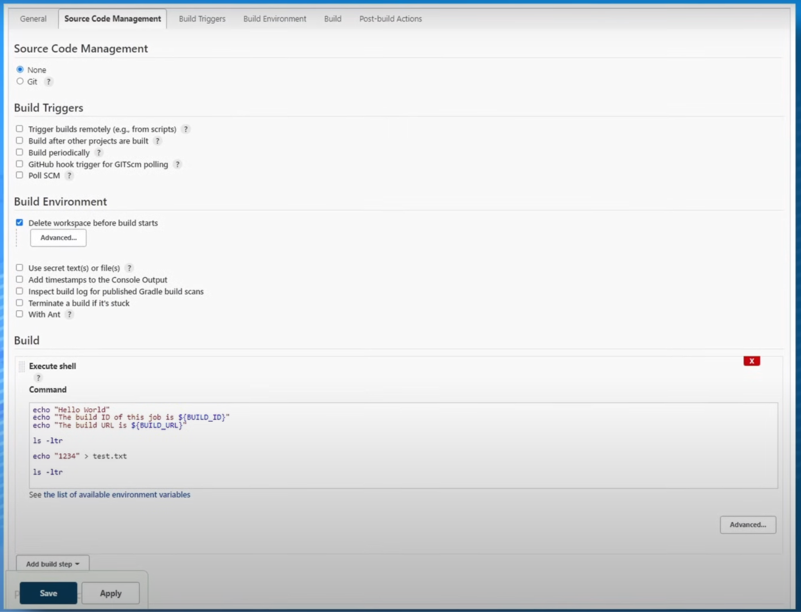

Slide 4
Jenkins Infrastructure
Jenkins Master
Controls Pipeline
Schedules builds
Agents/Minions
Perform the builds

Slide 5
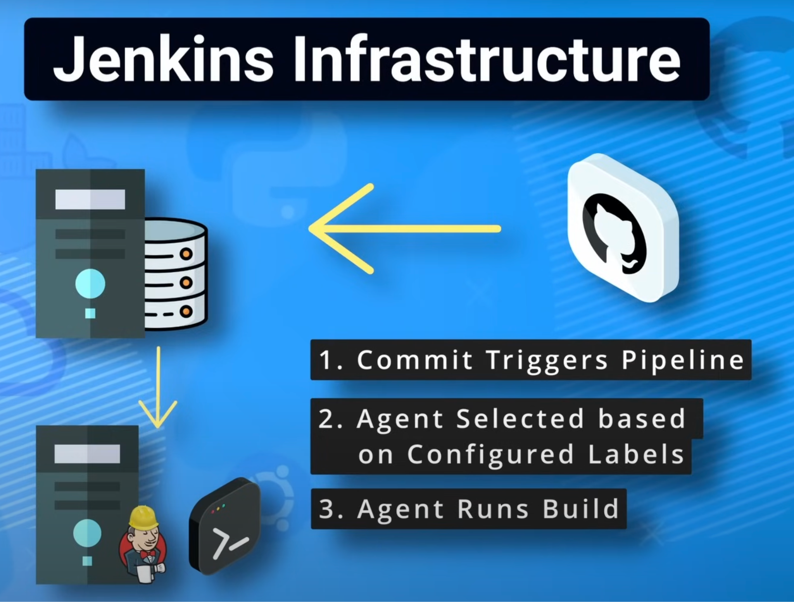
Example workflow illustrating the jenkins infrastructure

Slide 6
Jenkins Agent Types
Permanent Agents
Dedicated servers for running and building jobs
We have to make sure that all prerequisites are installed on the server
Cloud Agents
Ephemeral/Dynamic/Temp Agents spun up on demand based on a configured template
Examples - Docker, Kubernetes, ECS, e.t.c

Slide 7
Build Job Type
Freestyle
Basic way to create a build
Feels line Shell scripting that would be triggered
Recommended way for starting to learn how to write a build job
Pipelines
Use groovy syntax
Broken into stages and steps. E.g. Clone, build, test, package, deploy

Slide 8
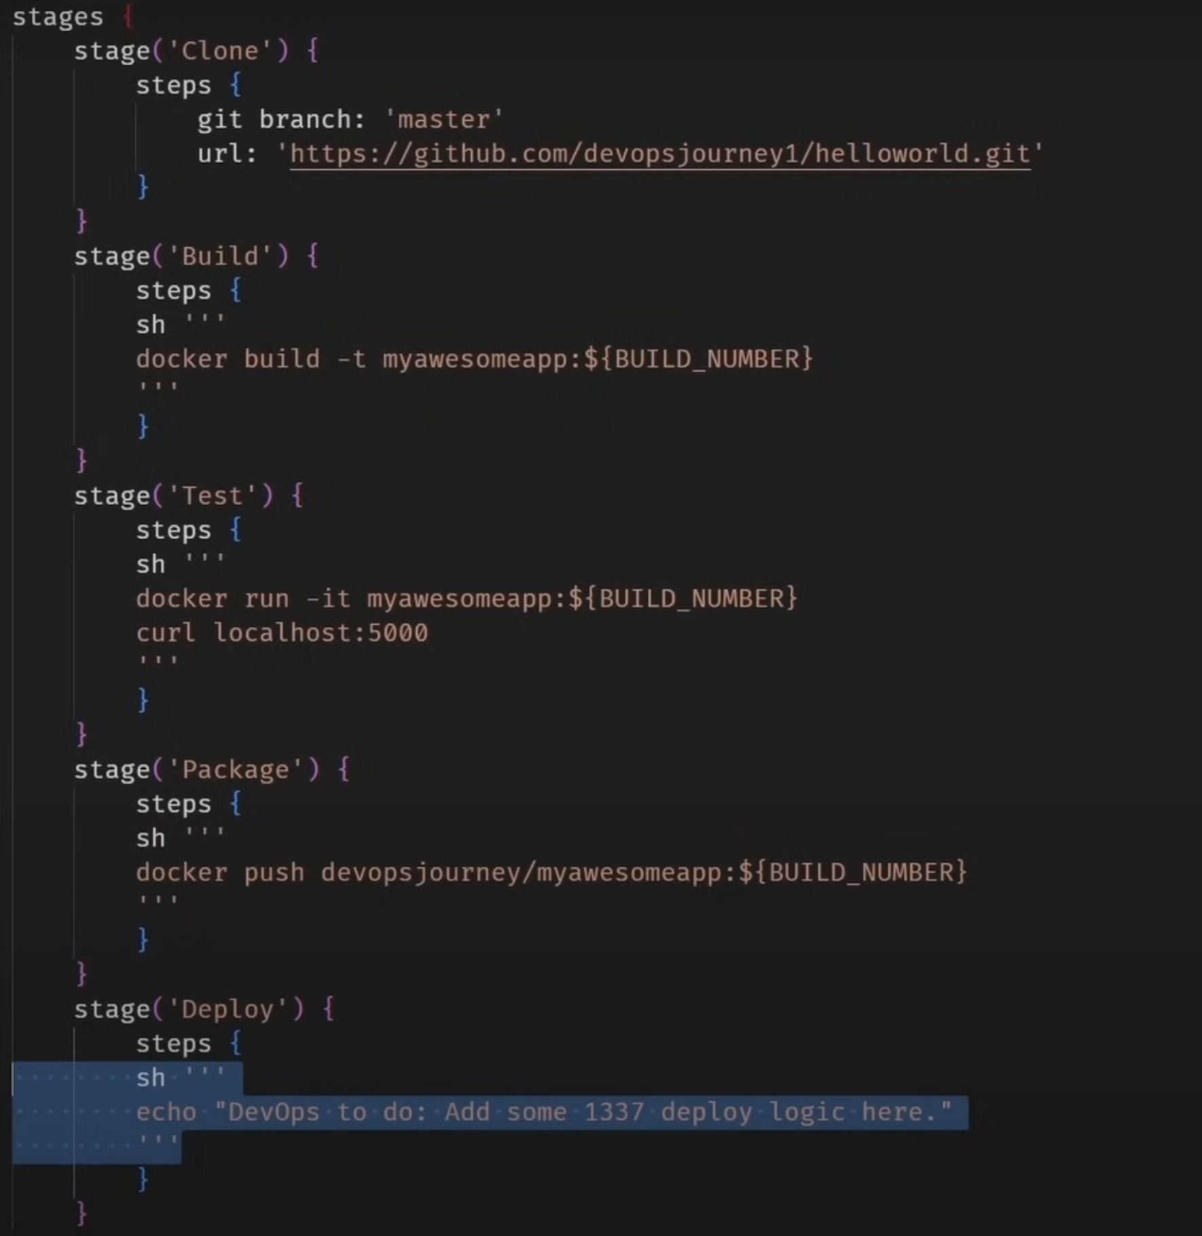

Slide 9
Jenkins is a CI/CD tool used by engineers to automate repetitive tasks in order to allow them be more productive

Slide 10
Installing Jenkins
https://www.jenkins.io/doc/book/
Task 1
Build and install Jenkins

Slide 11
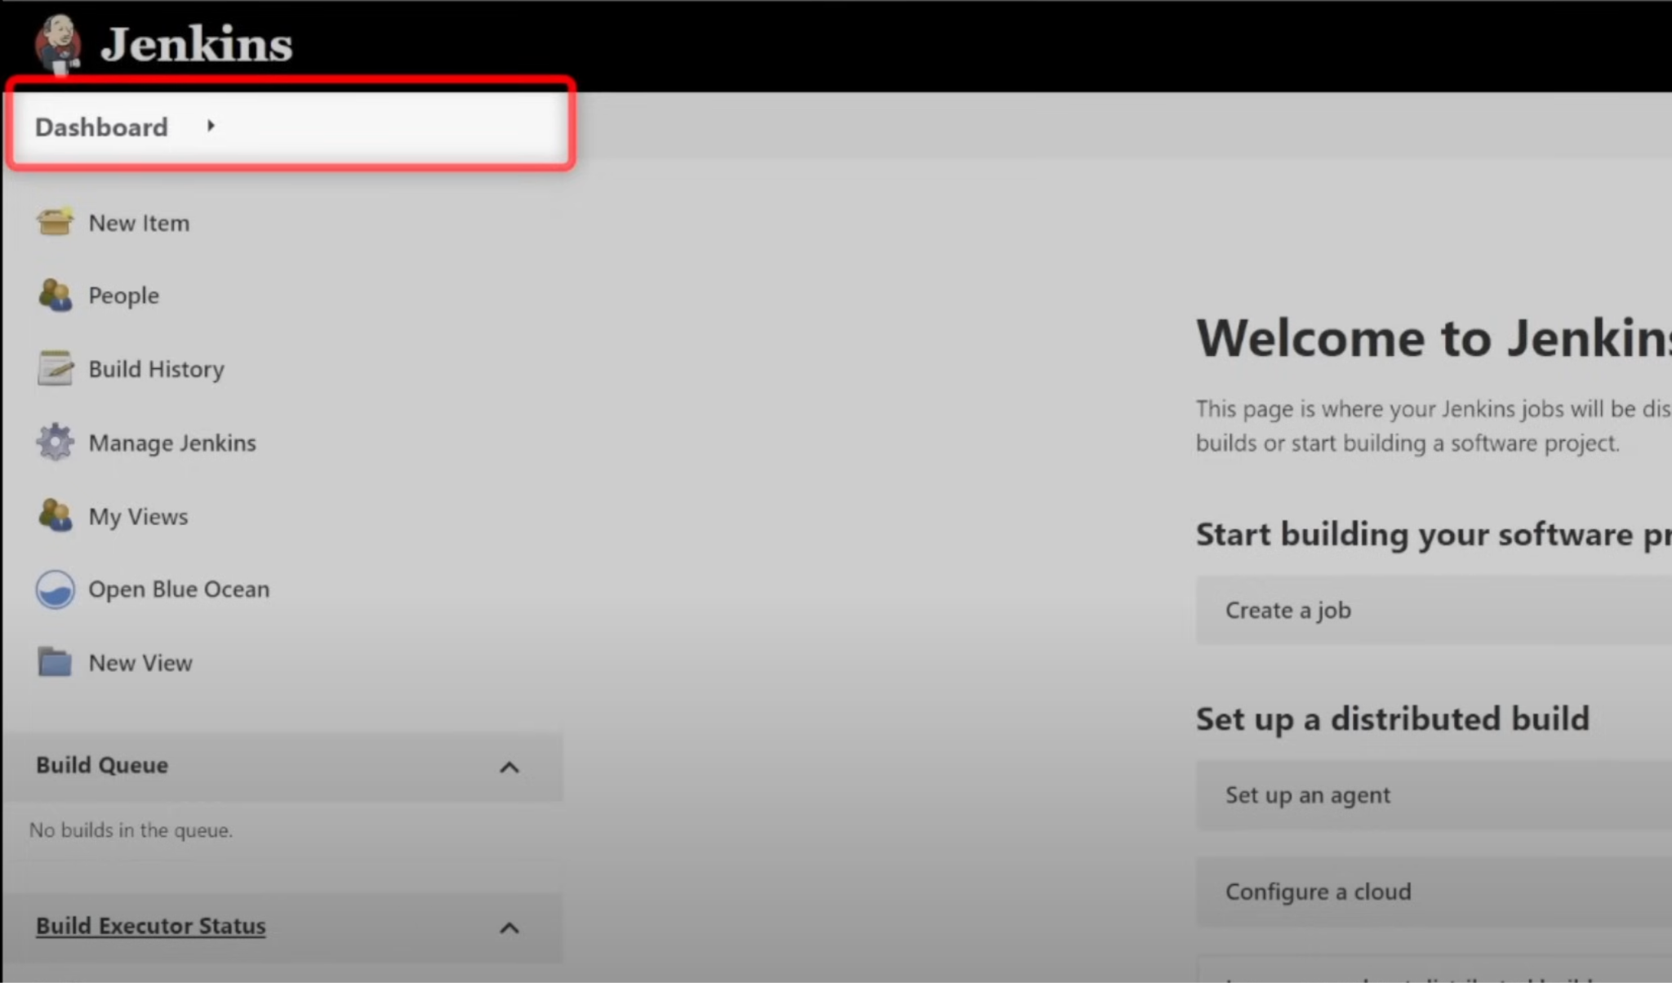

Slide 12
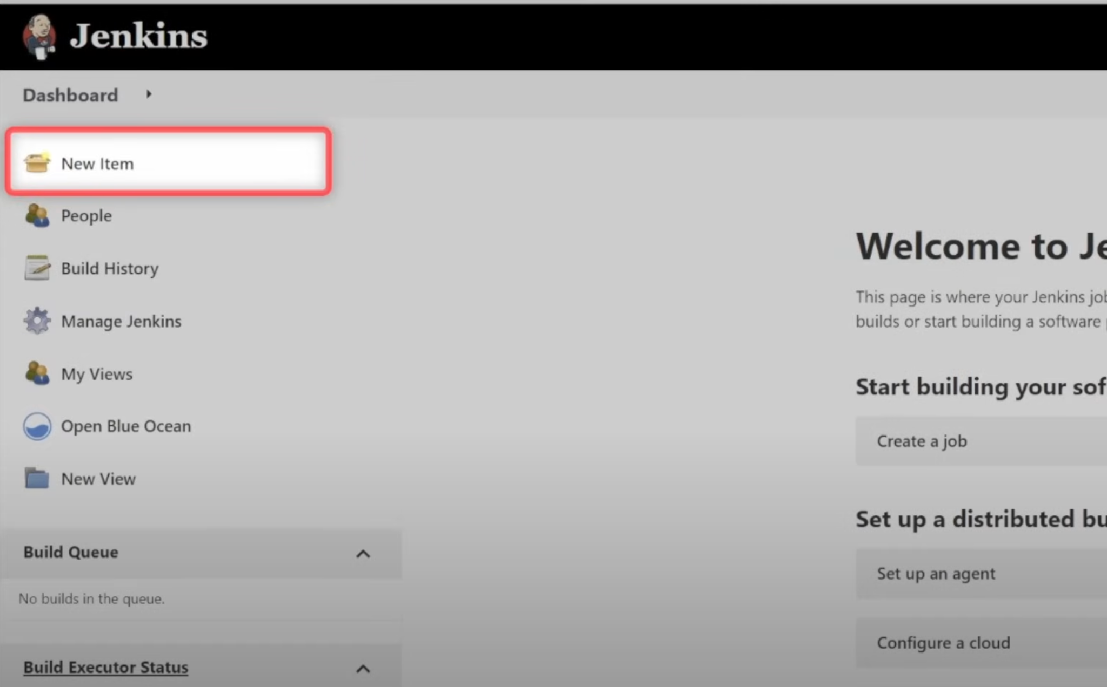

Slide 13
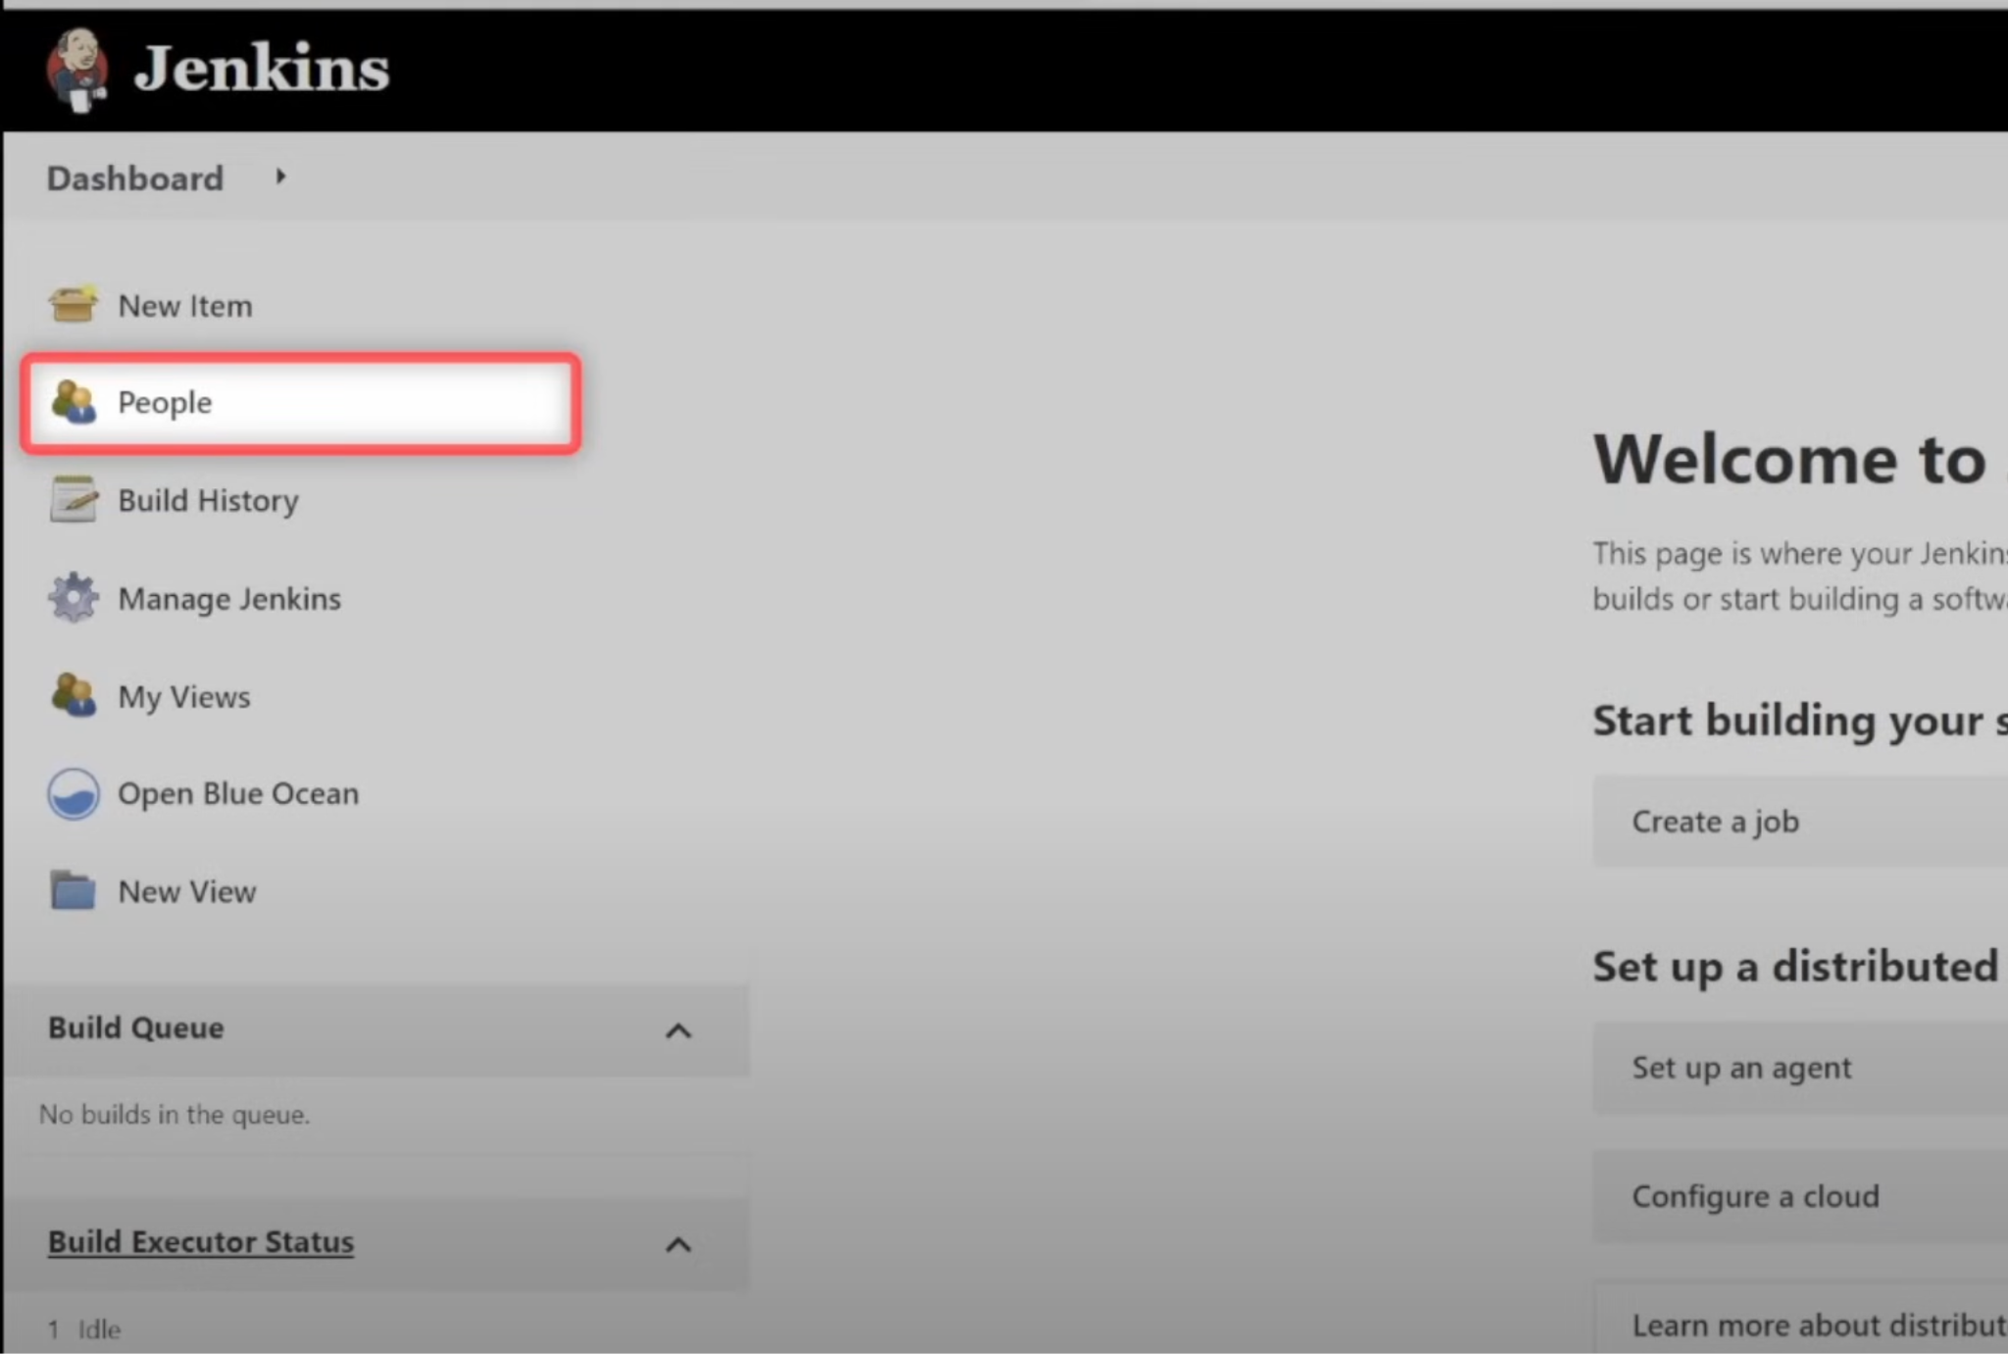

Slide 14
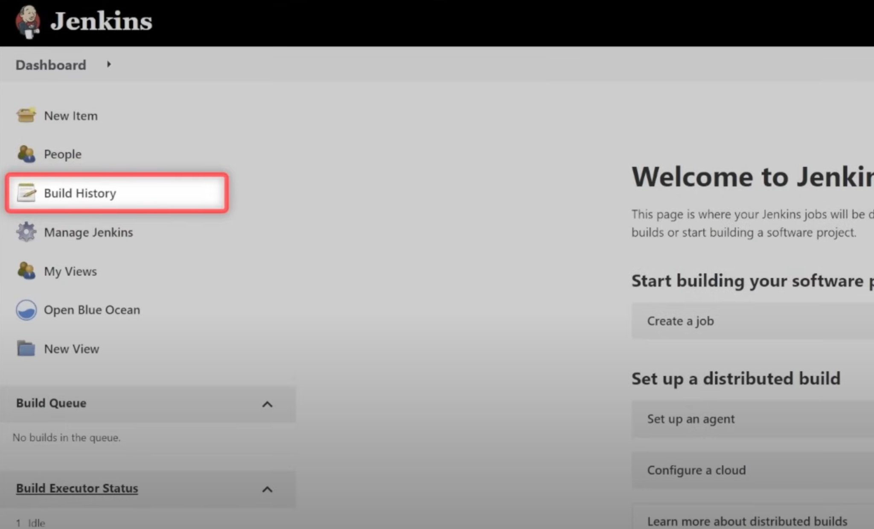

Slide 15
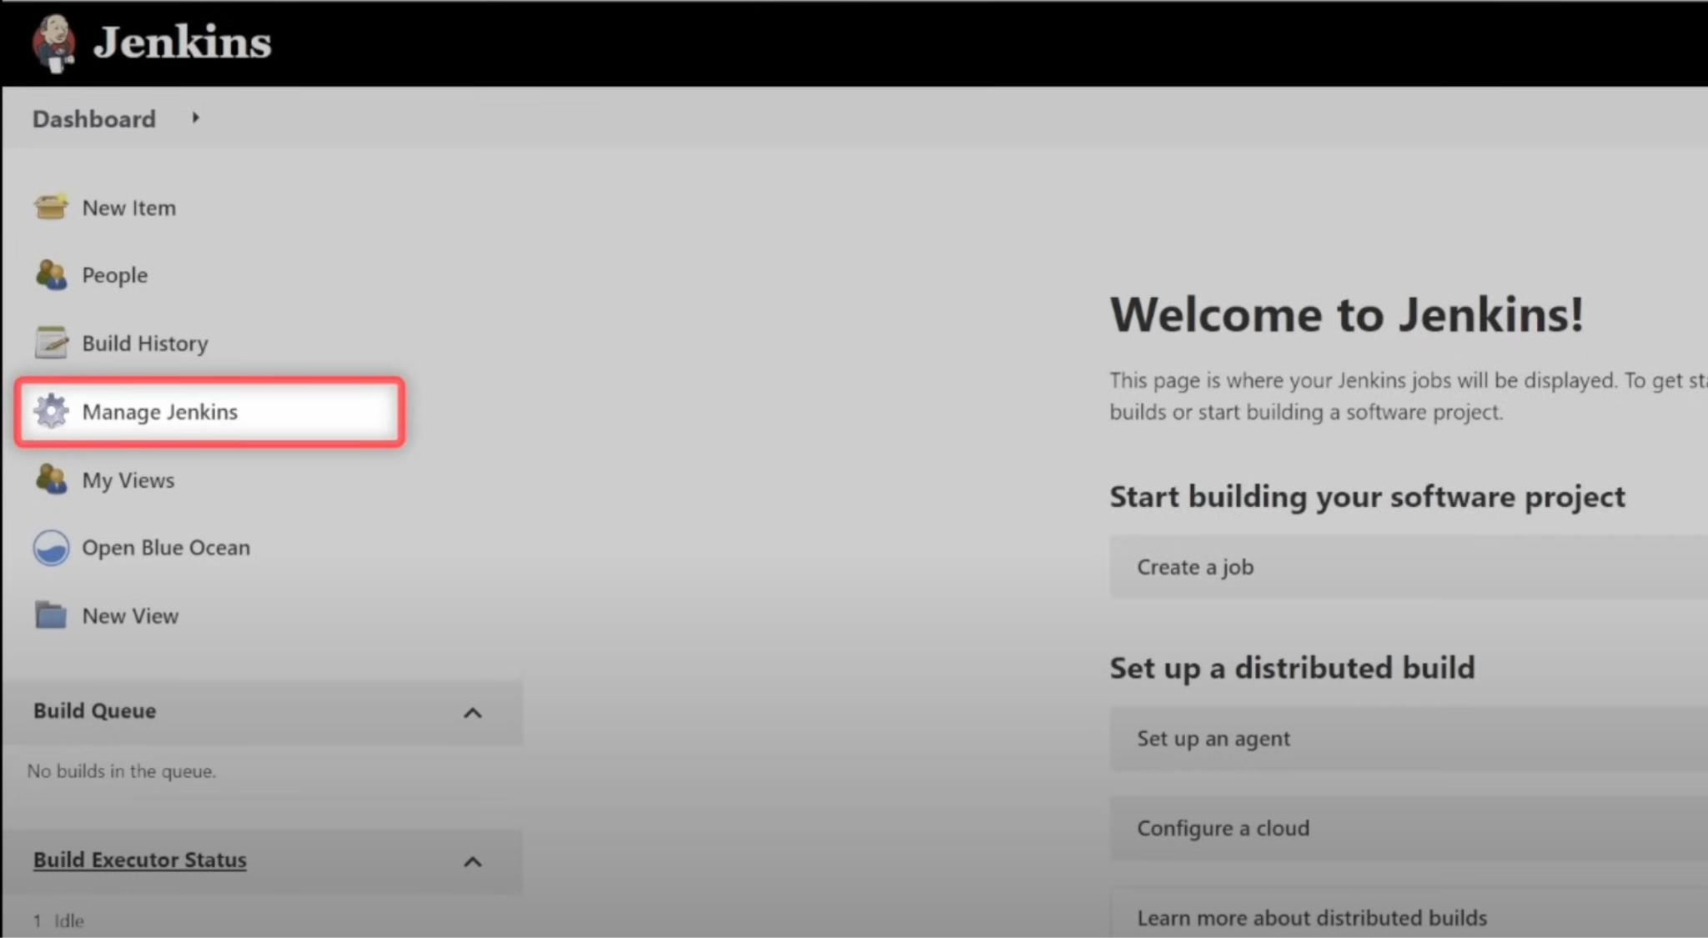

Slide 16
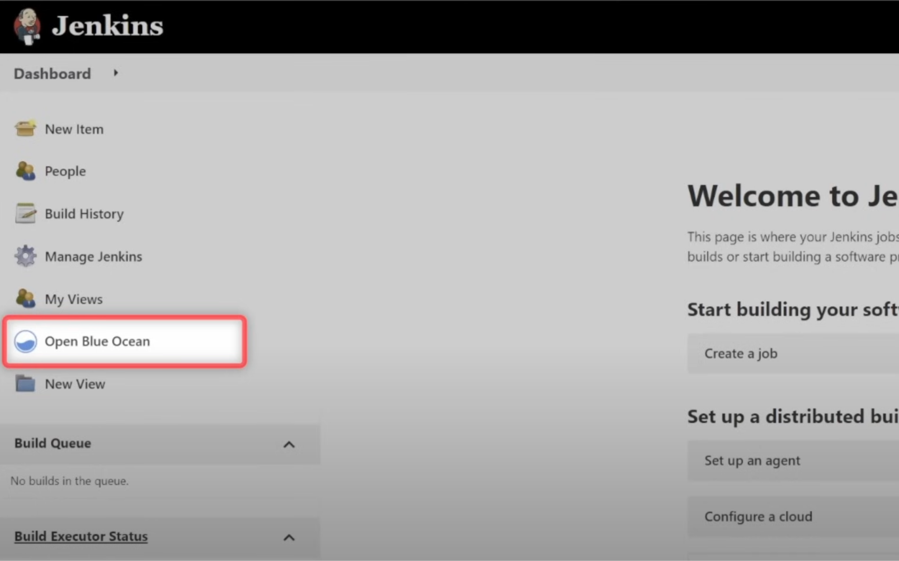

Slide 17
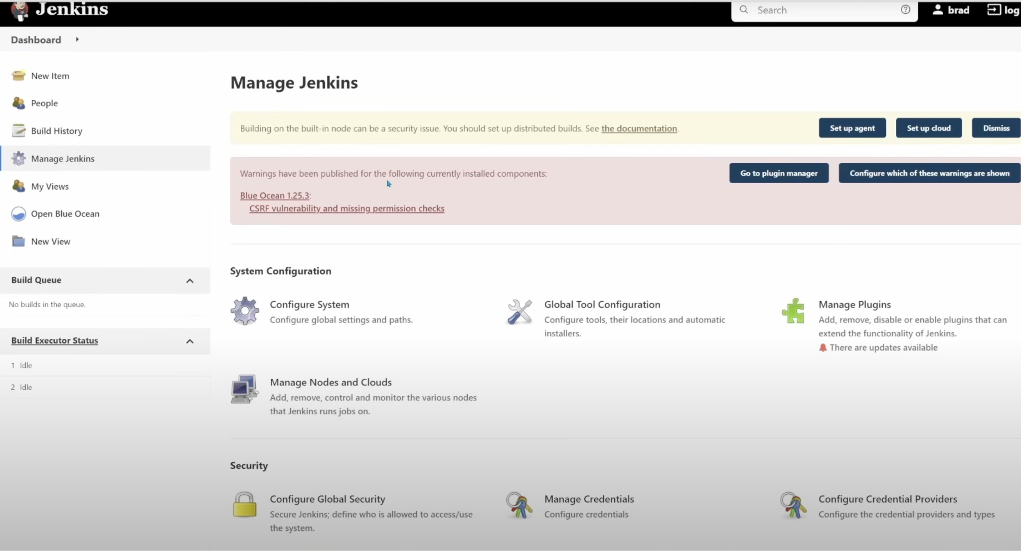
https://www.jenkins.io/doc/book/managing/

Slide 18
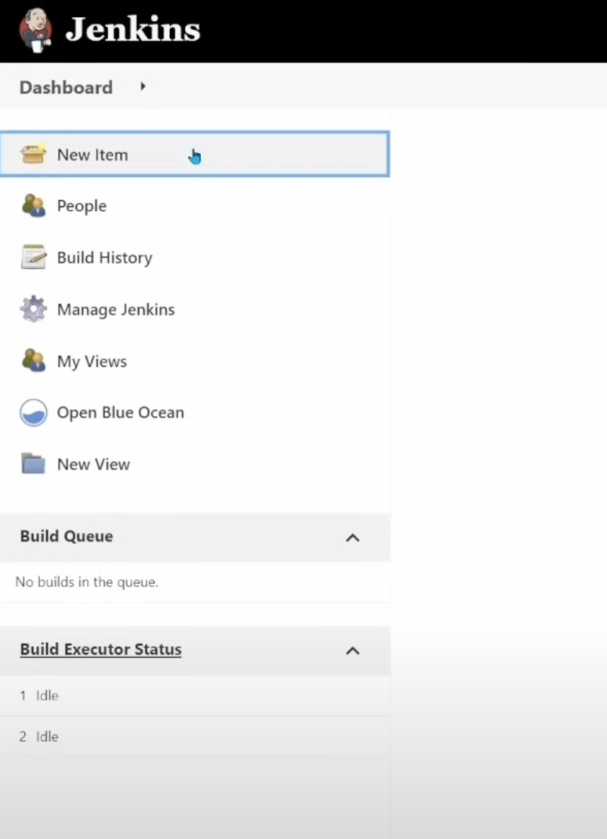
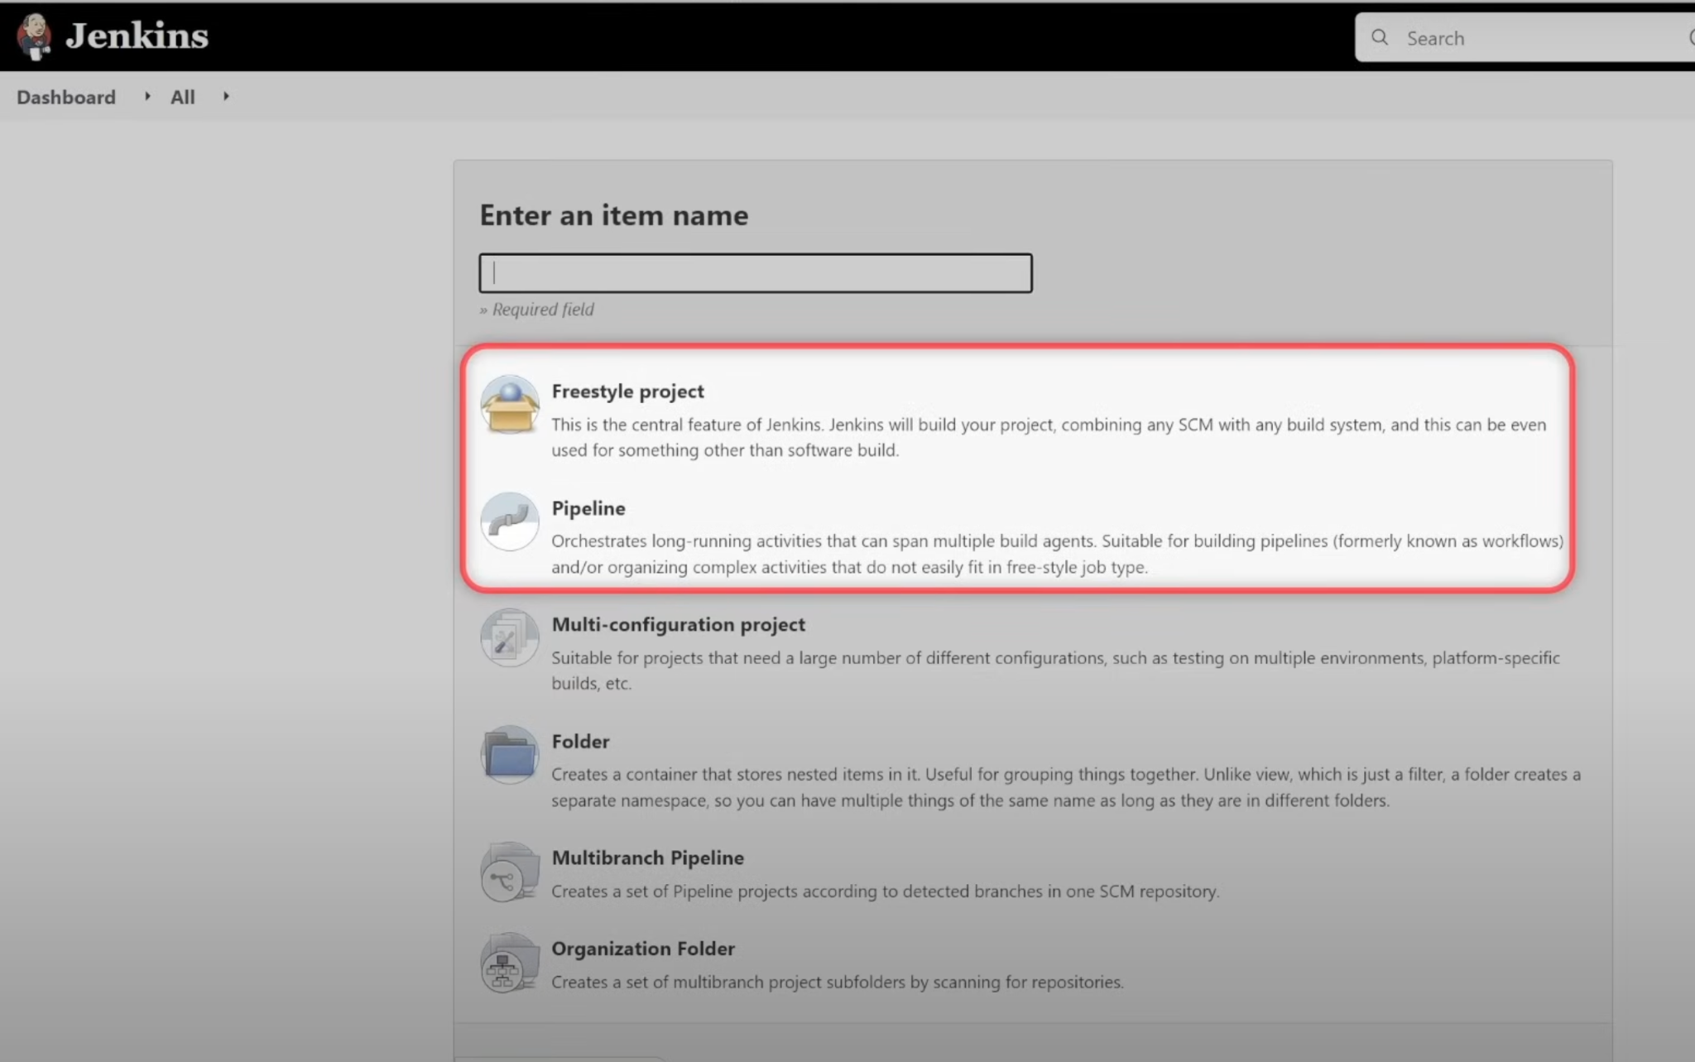
Create first jenkins project

Slide 19
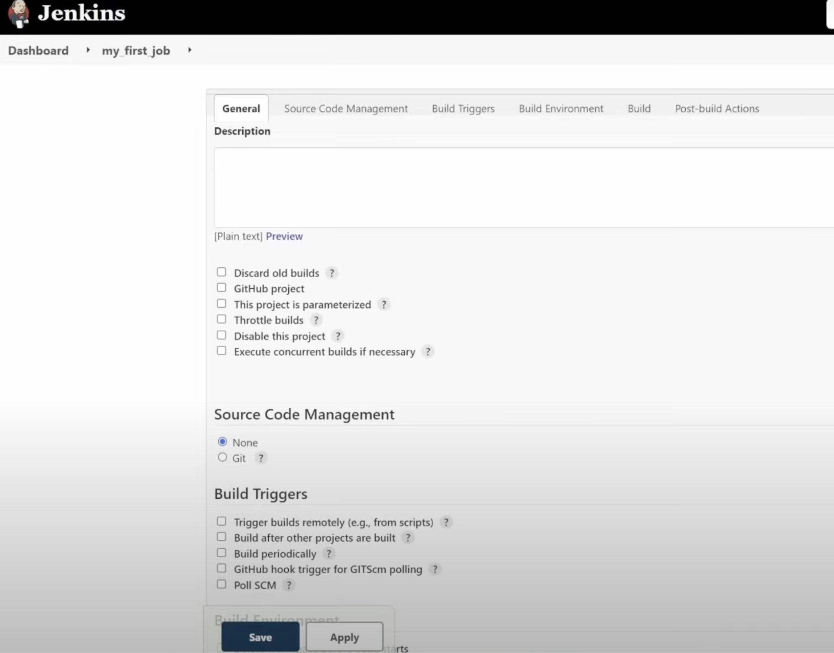
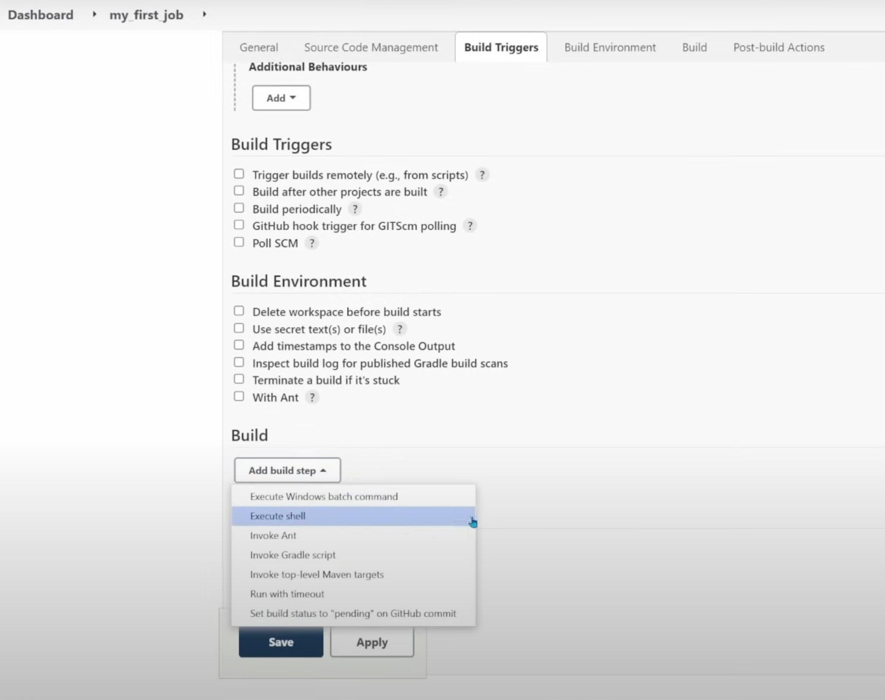
Project Settings

Slide 20
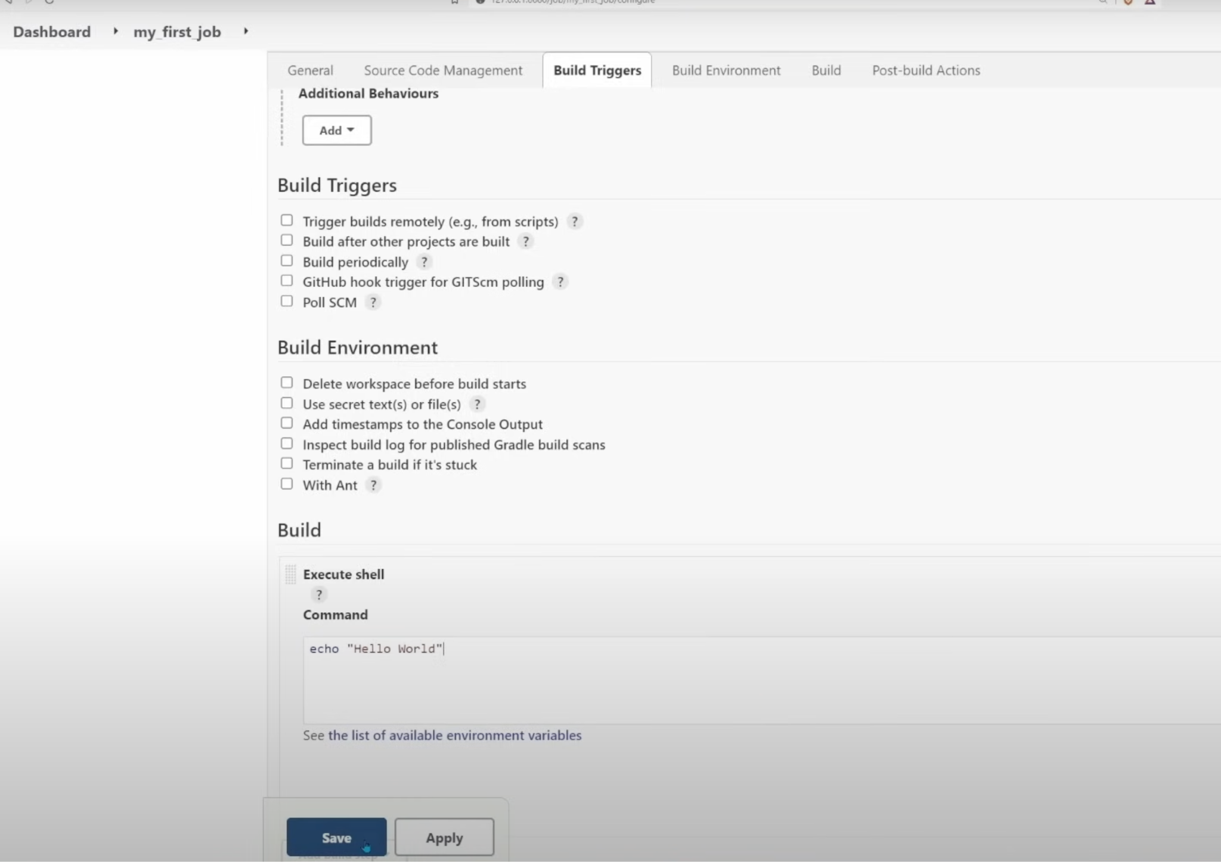

Slide 21
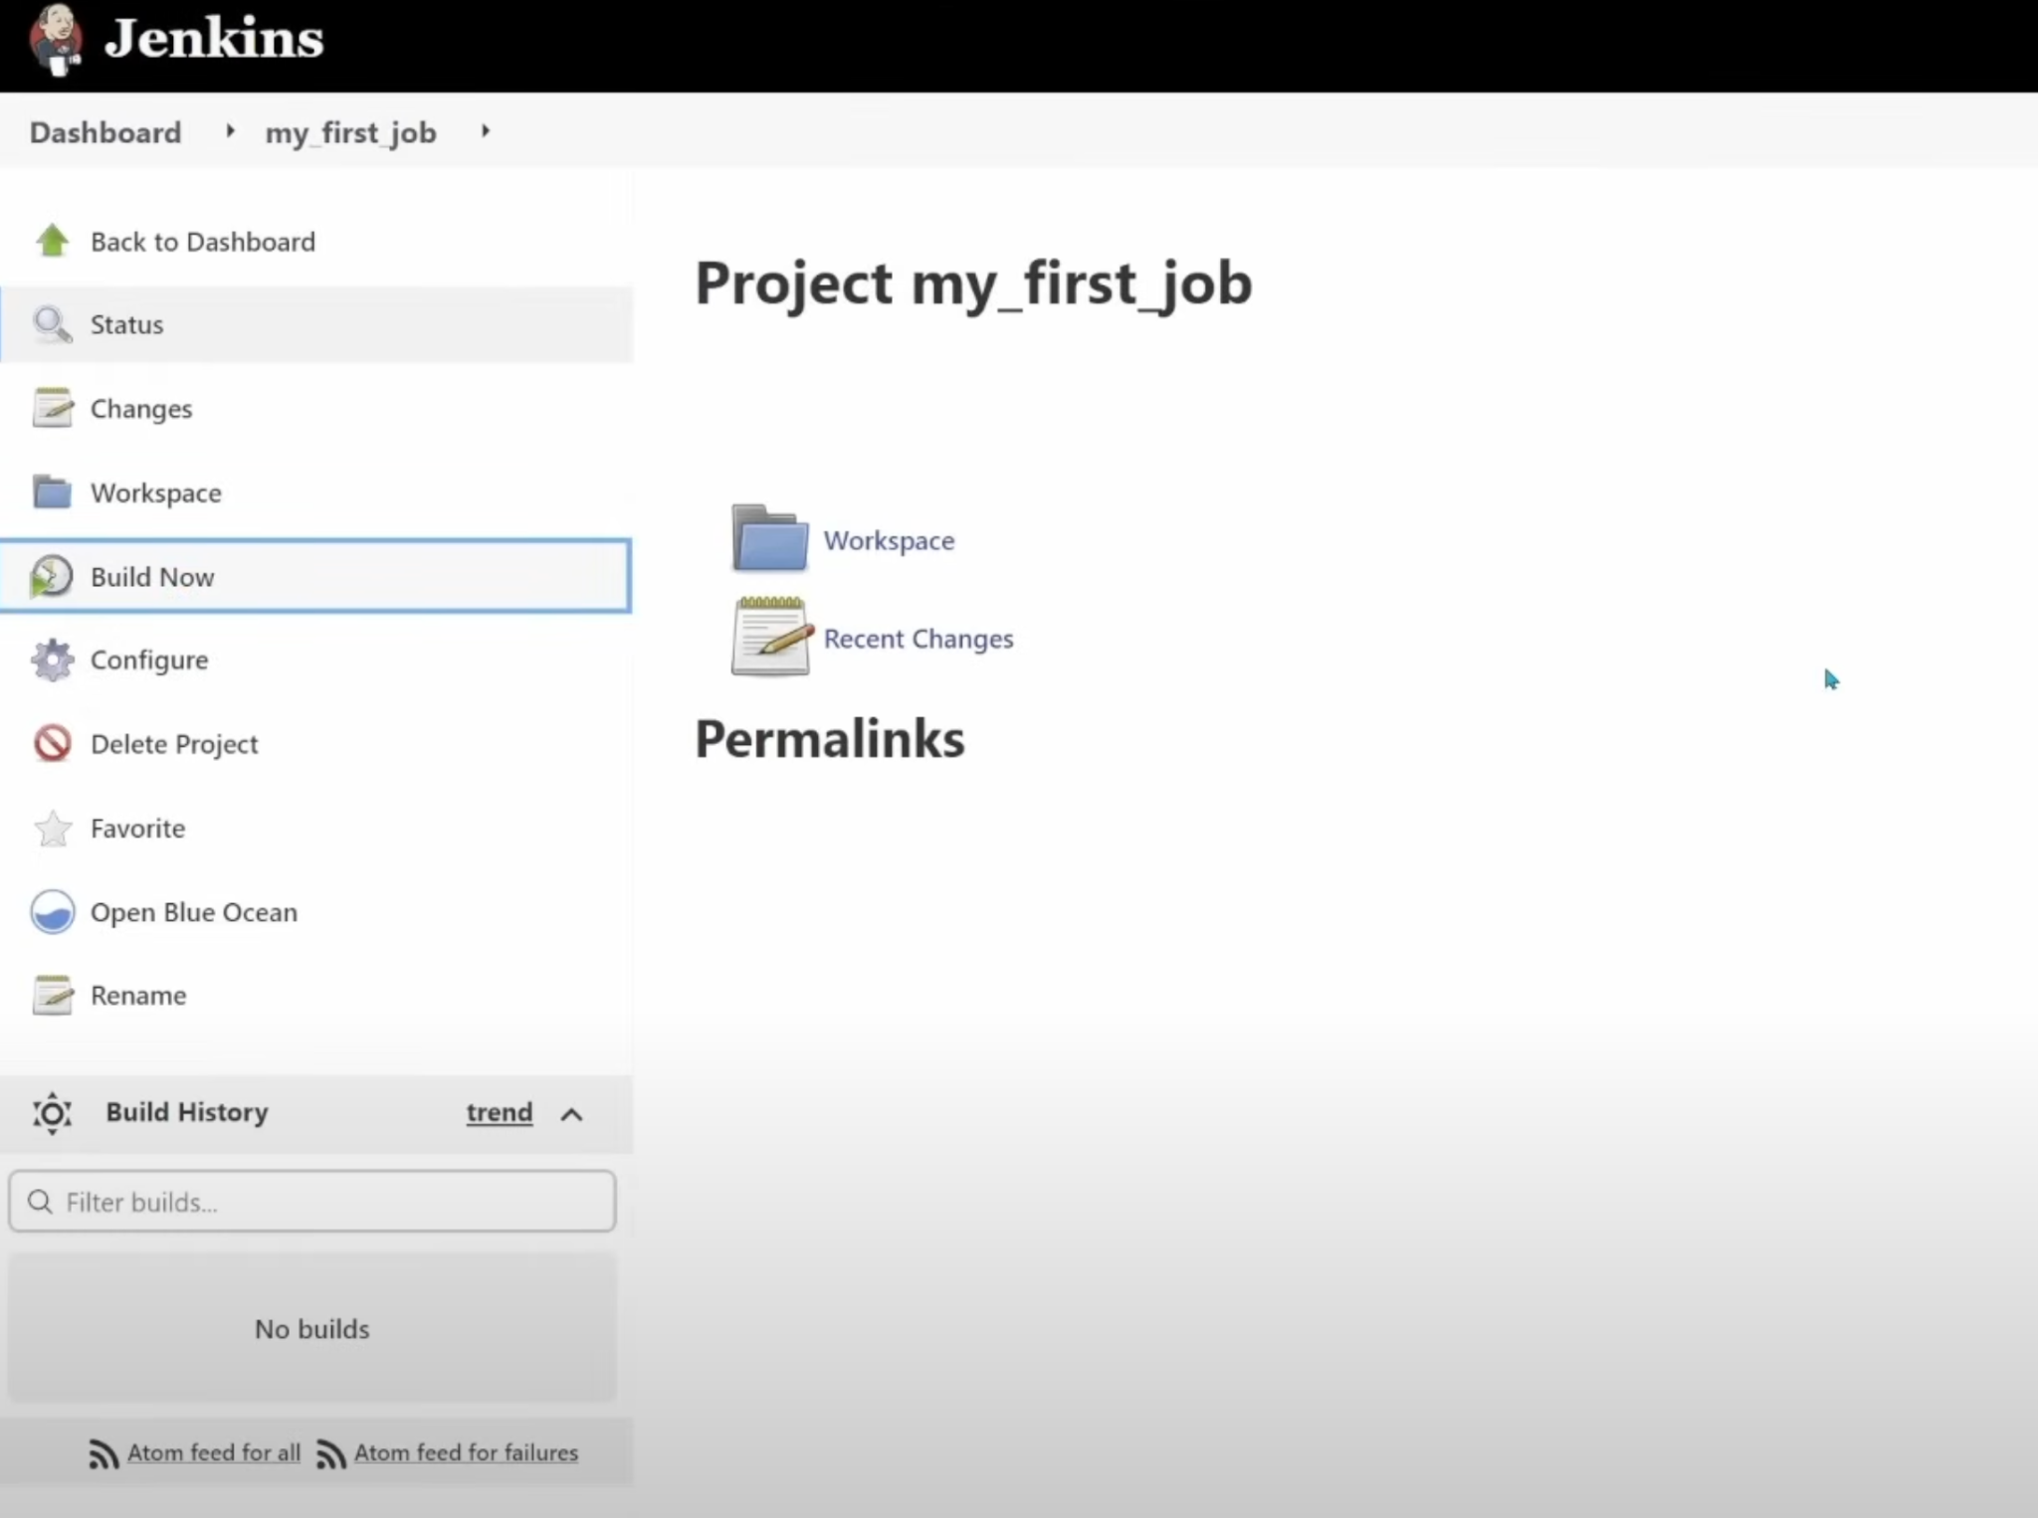

Slide 22
Exercise
Create more freestyle jobs

Slide 23
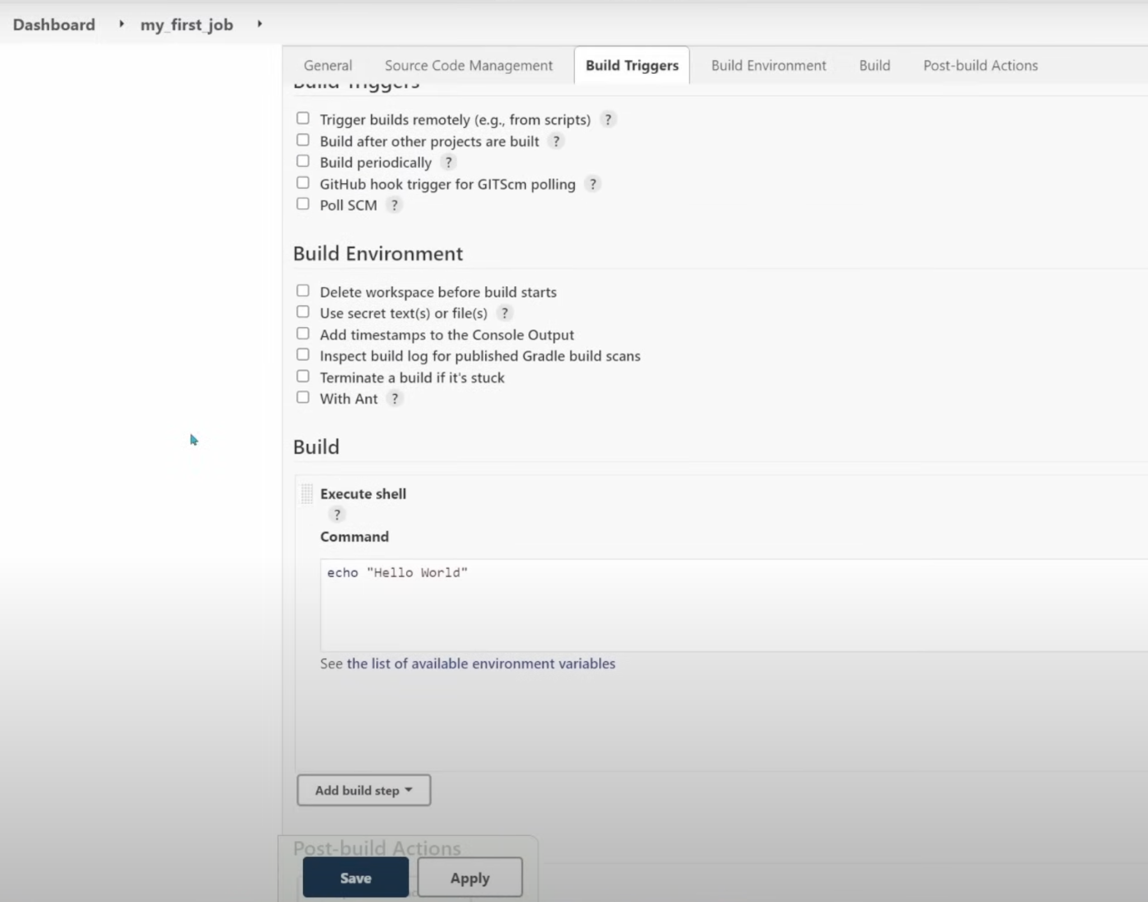
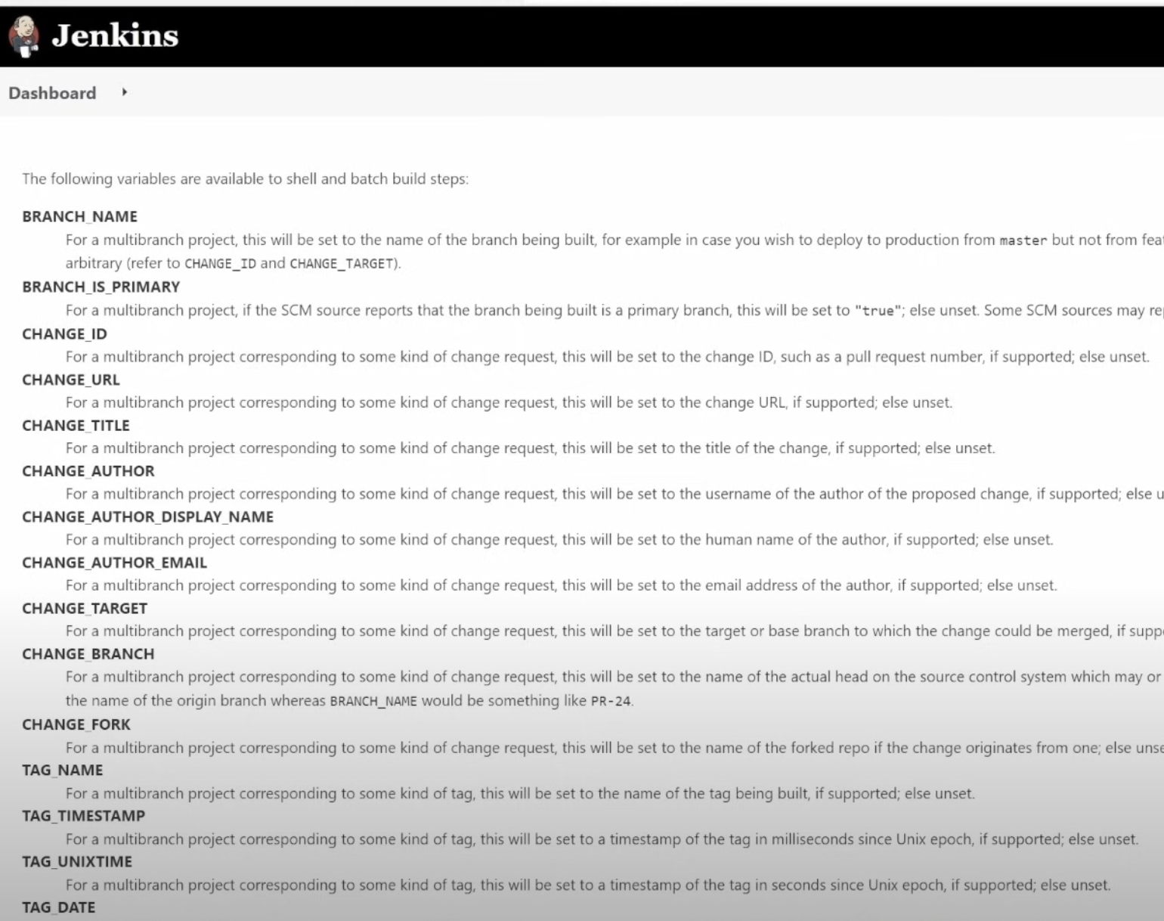
Jobs with Environment variables

Slide 24
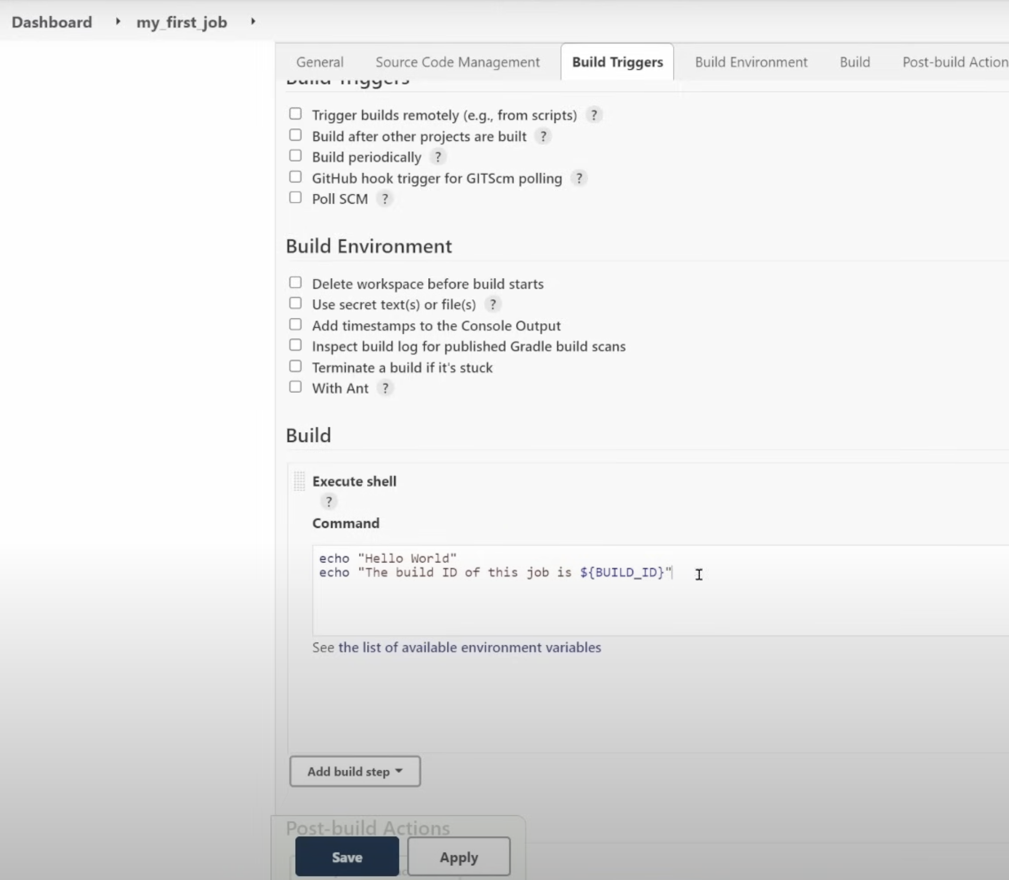

Slide 25
Exercise
Create more freestyle jobs with Environment variables

Slide 26
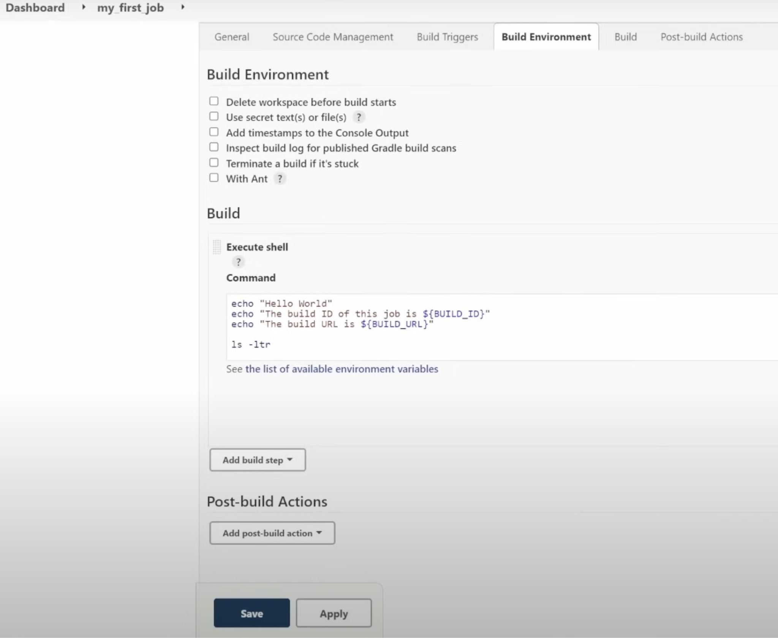
Jenkins workspace

Slide 27
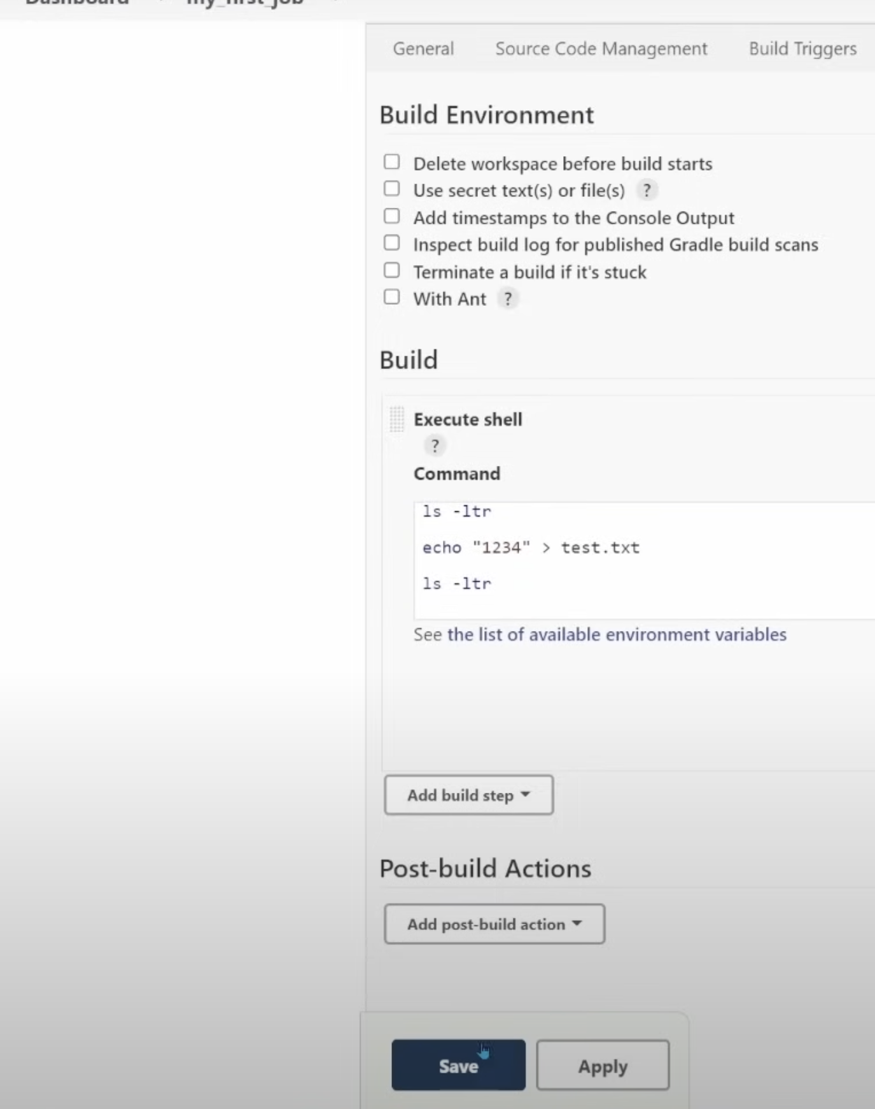
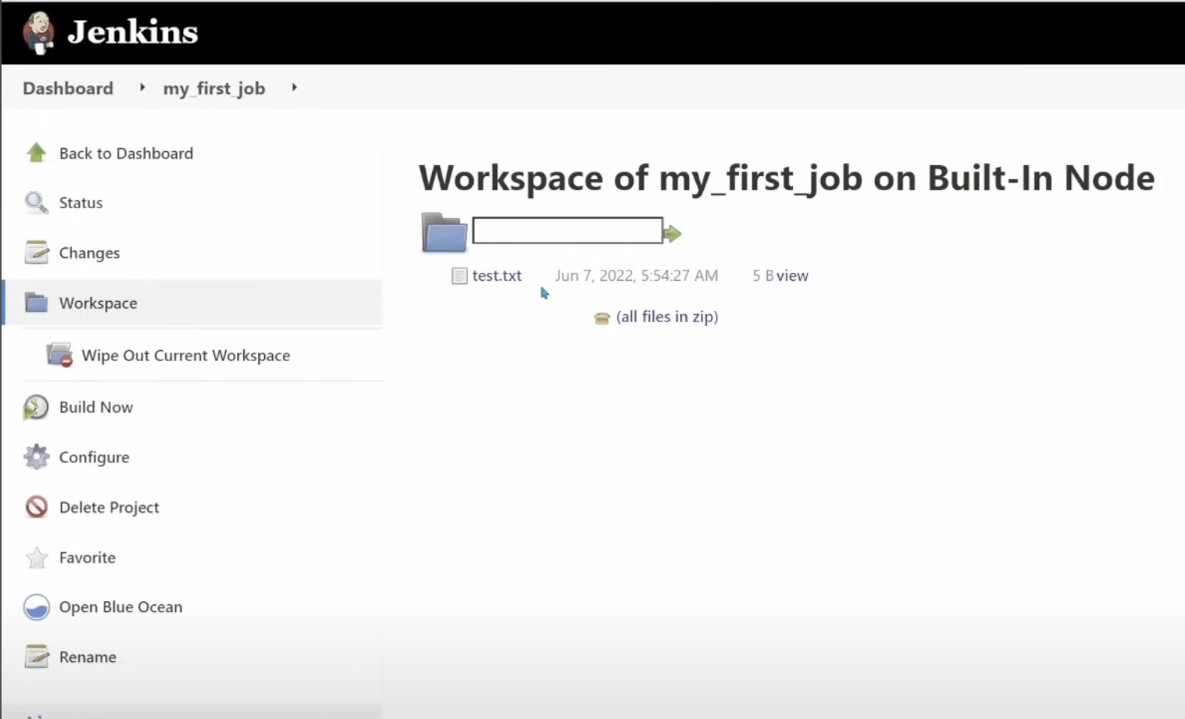

Slide 28
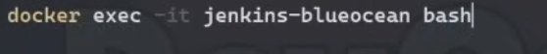
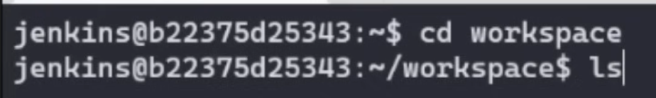
Explore Jenkins file system

Slide 29
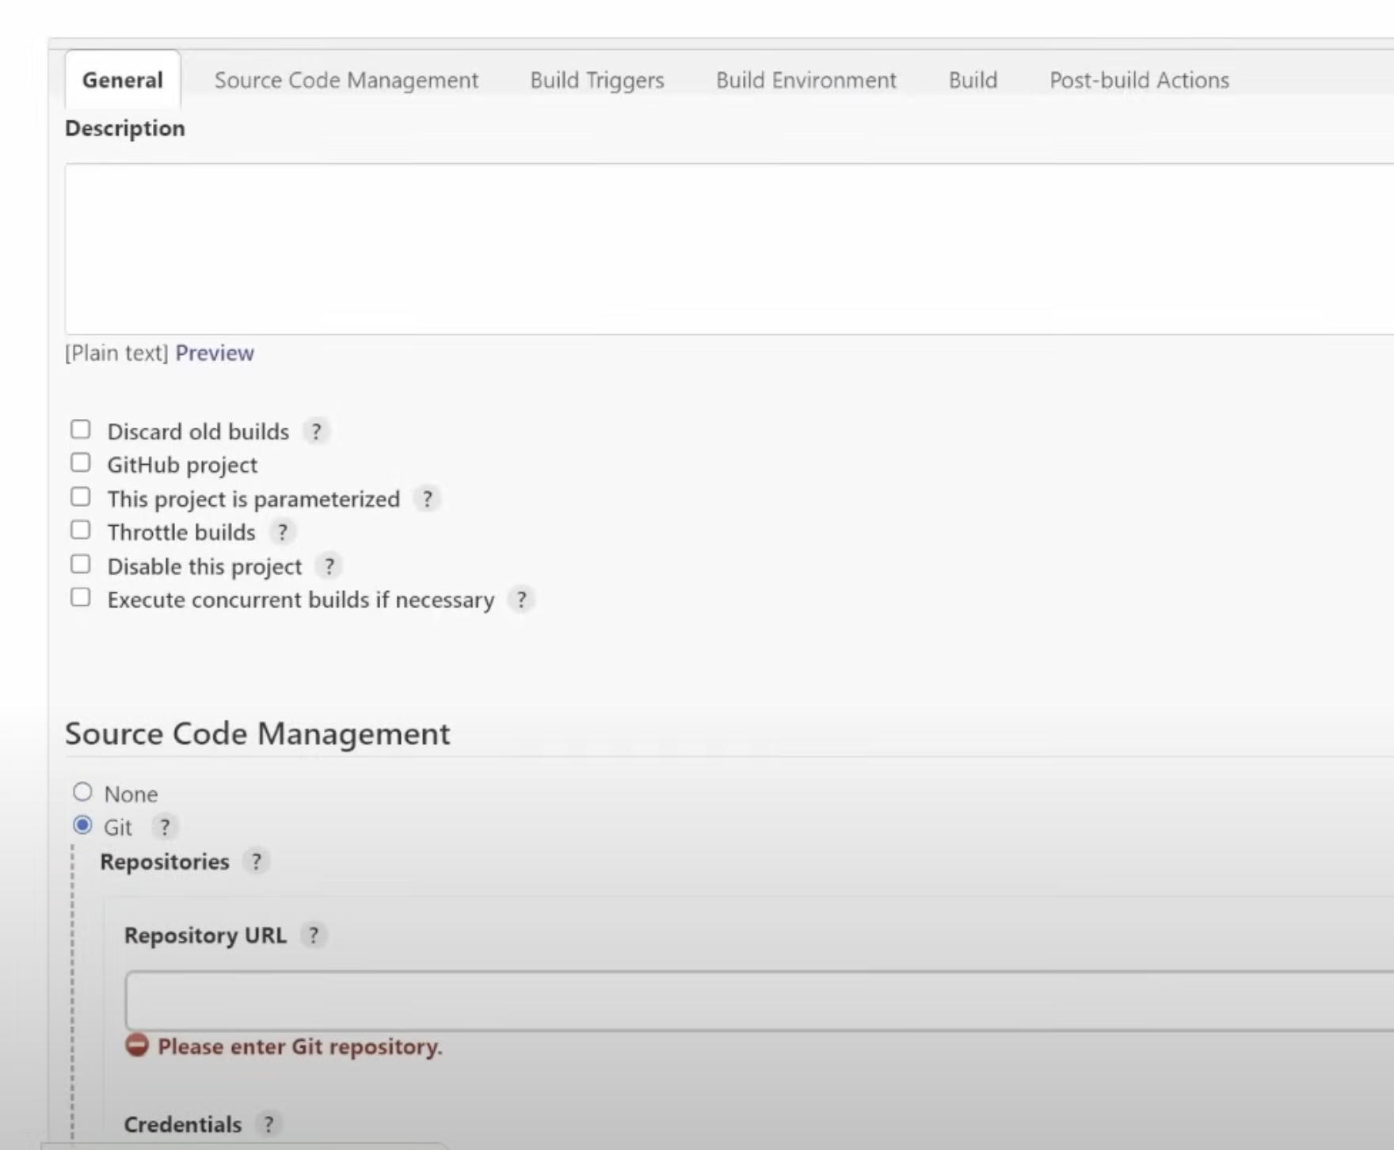
Create freestyle job with Github Source Code managent

Slide 30
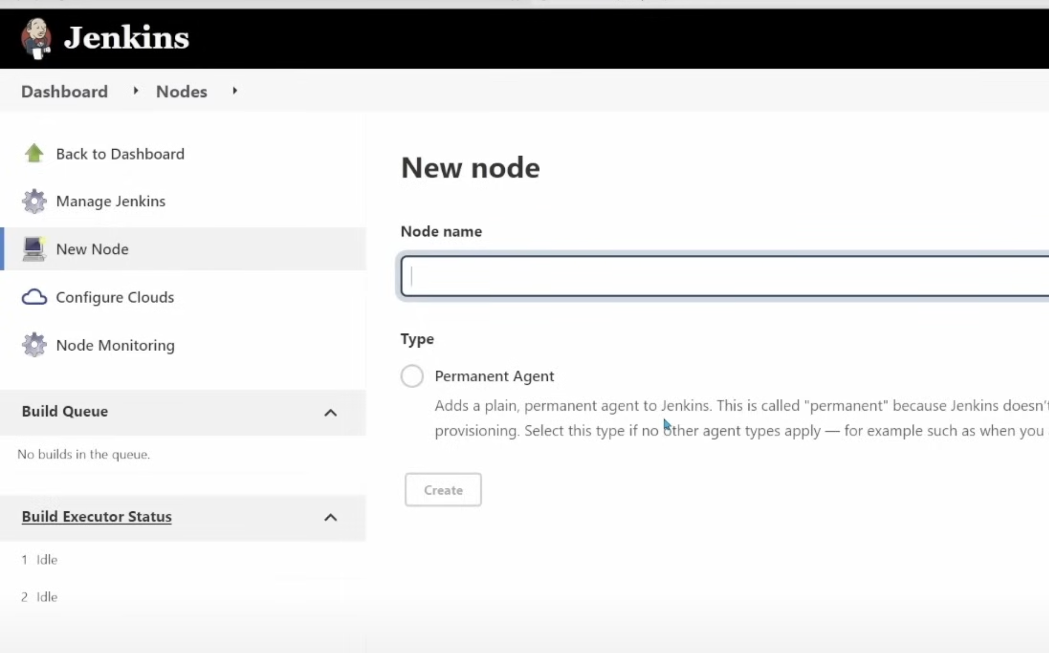
Configuring permanent agents

Slide 31
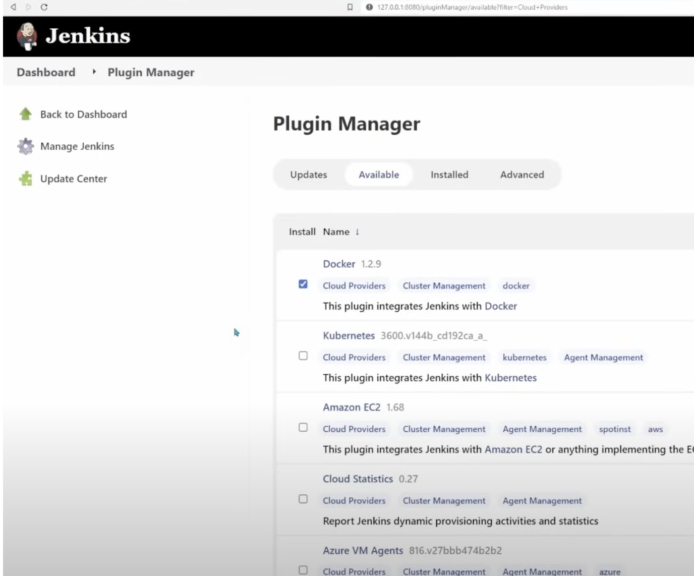
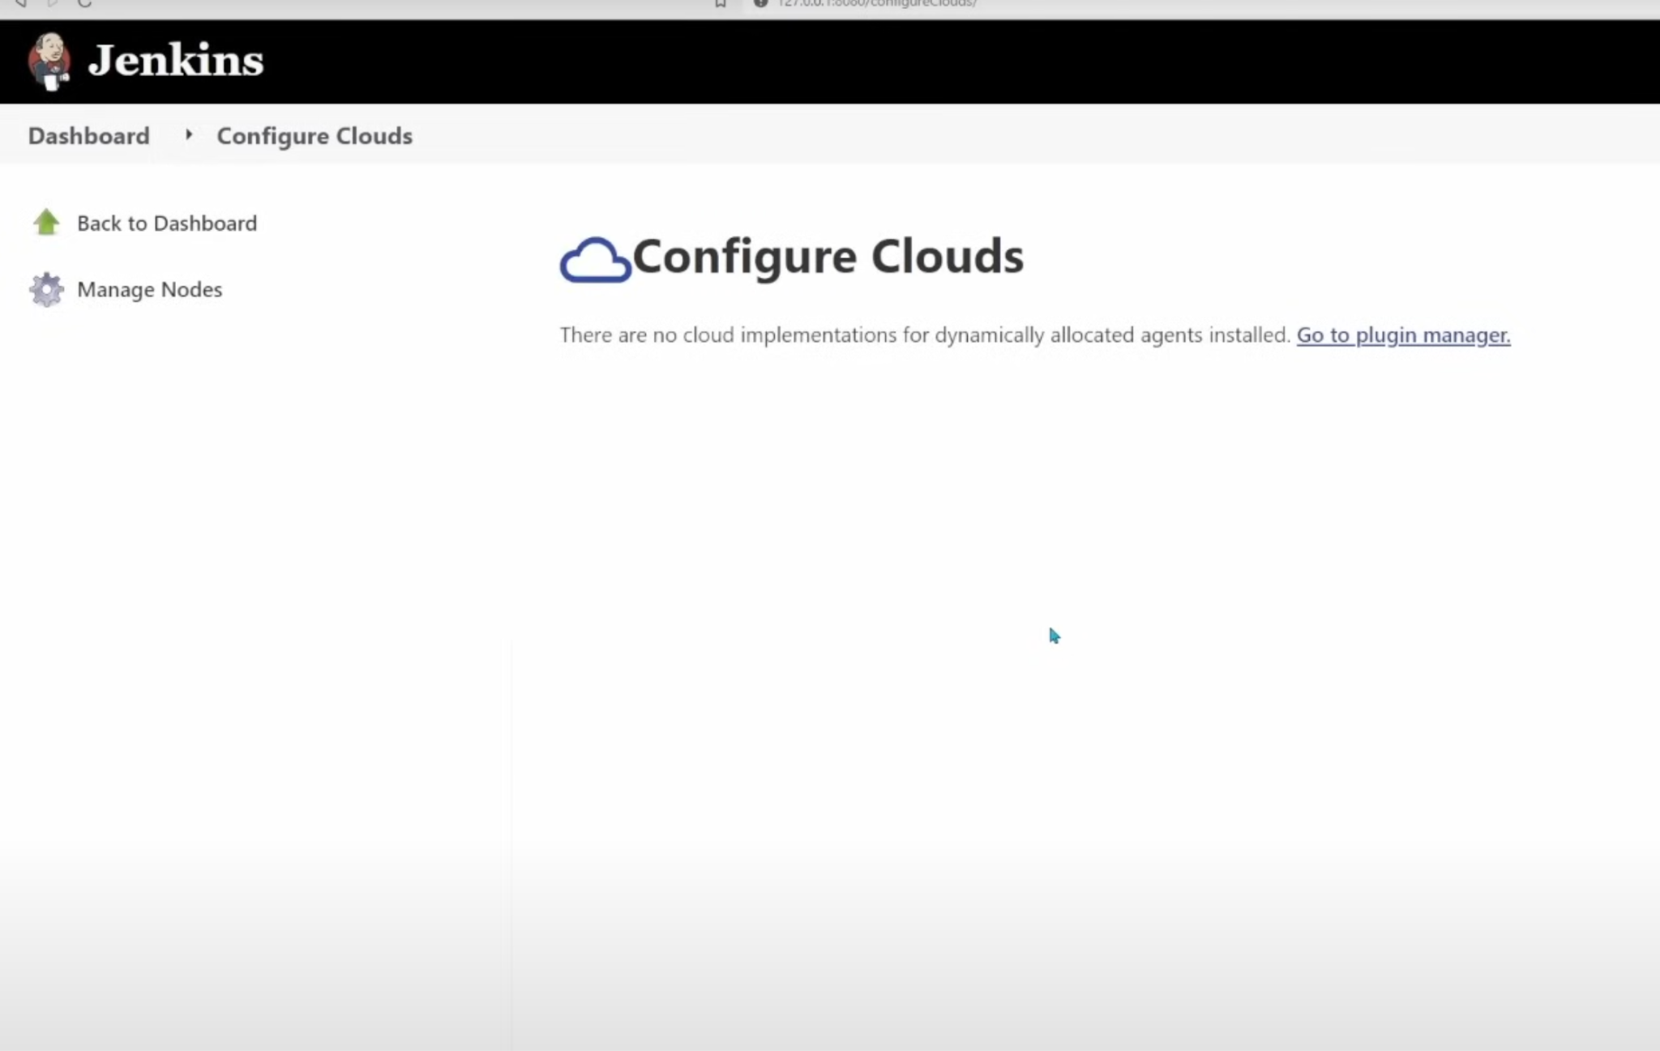
Configuring cloud agents

Slide 32
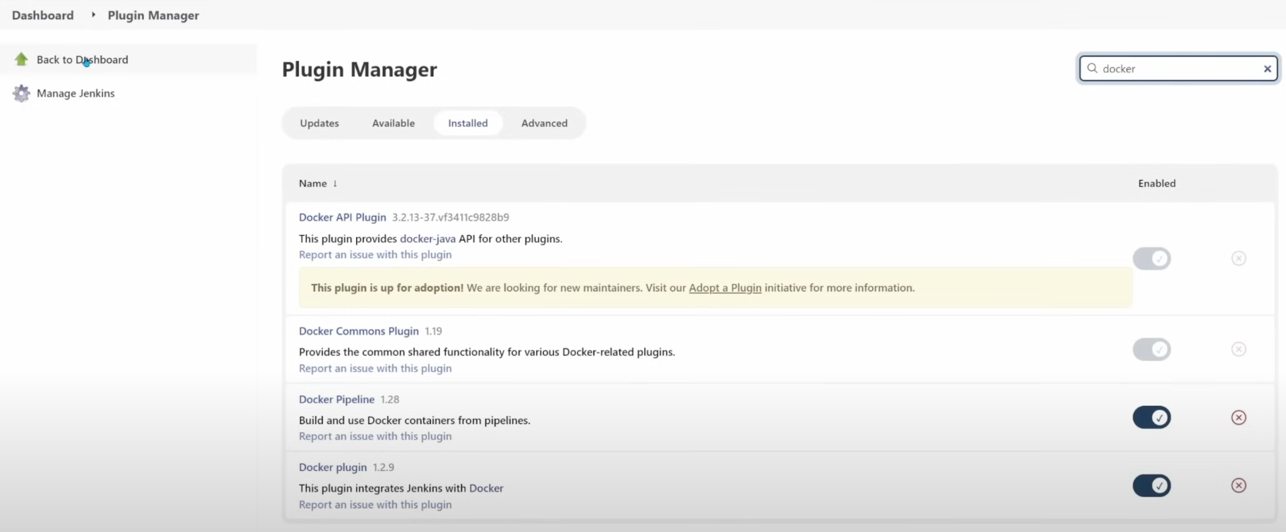

Slide 33
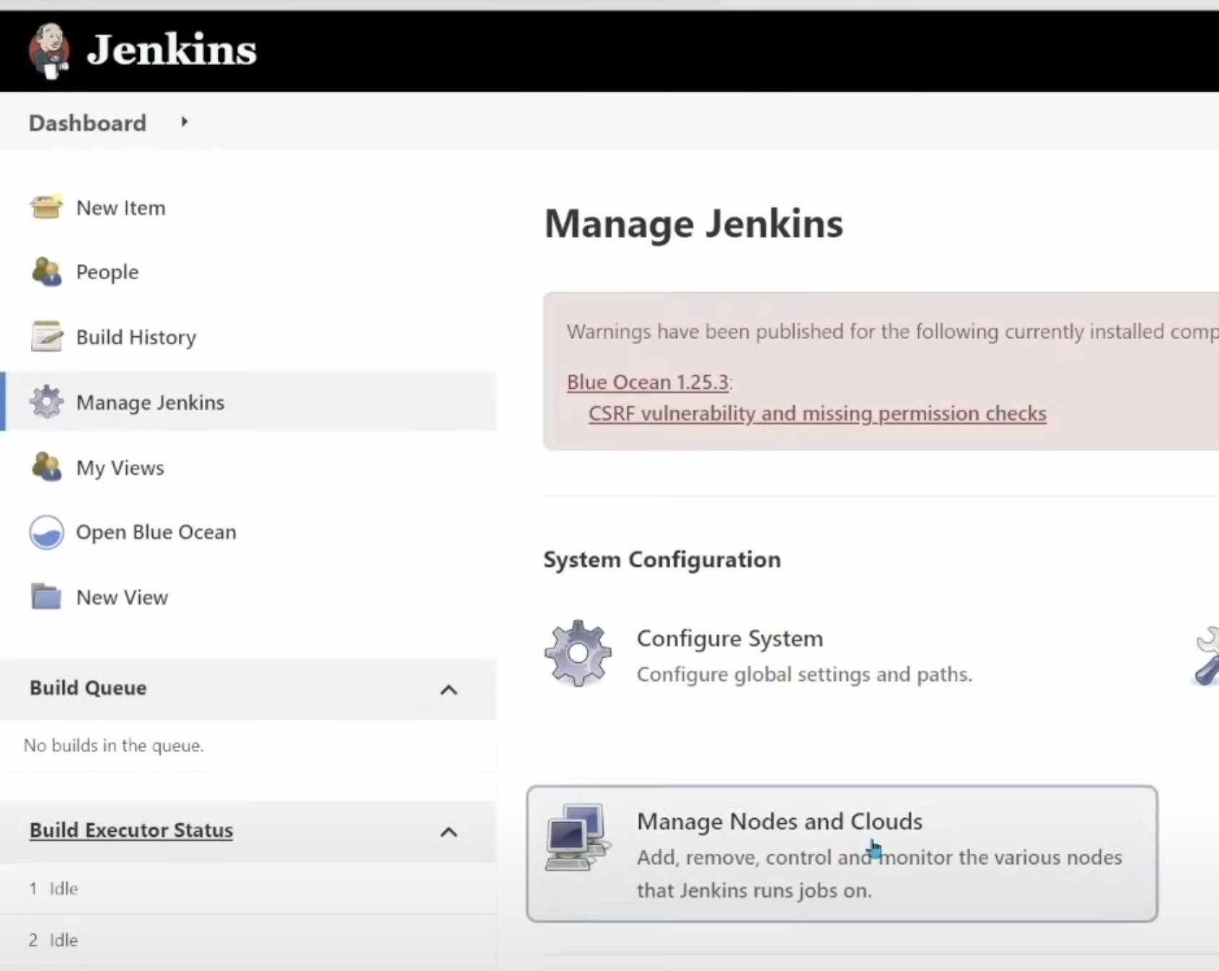
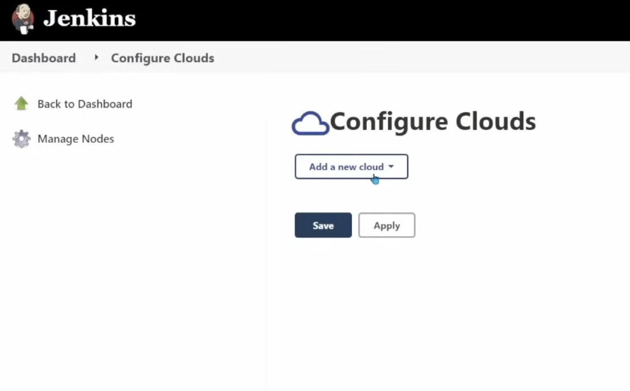

Slide 34
Create agent connector
proxy connection from jenkins master to localhost by running
docker run -d --restart=always -p 127.0.0.1:2376:2375 --network jenkins -v /var/run/docker.sock:/var/run/docker.sock alpine/socat tcp-listen:2375,fork,reuseaddr unix-connect:/var/run/docker.sock
Get proxy IP
docker inspect "$(docker container ls |grep alpine/socat |awk '{print $1}')" | grep IPAddress

Slide 35
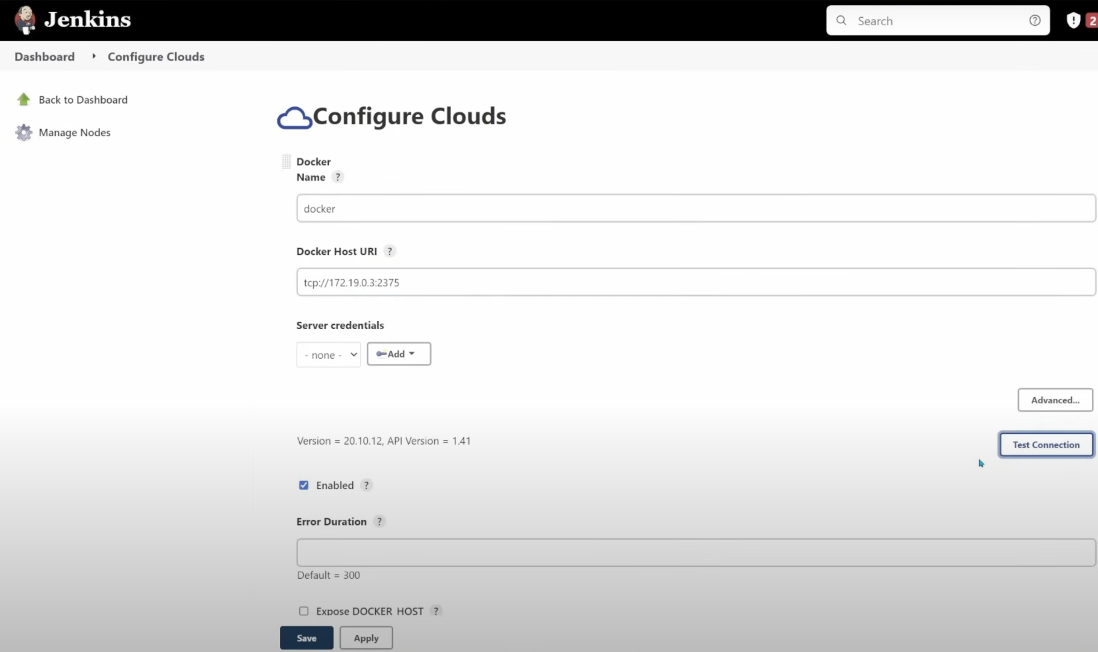

Slide 36
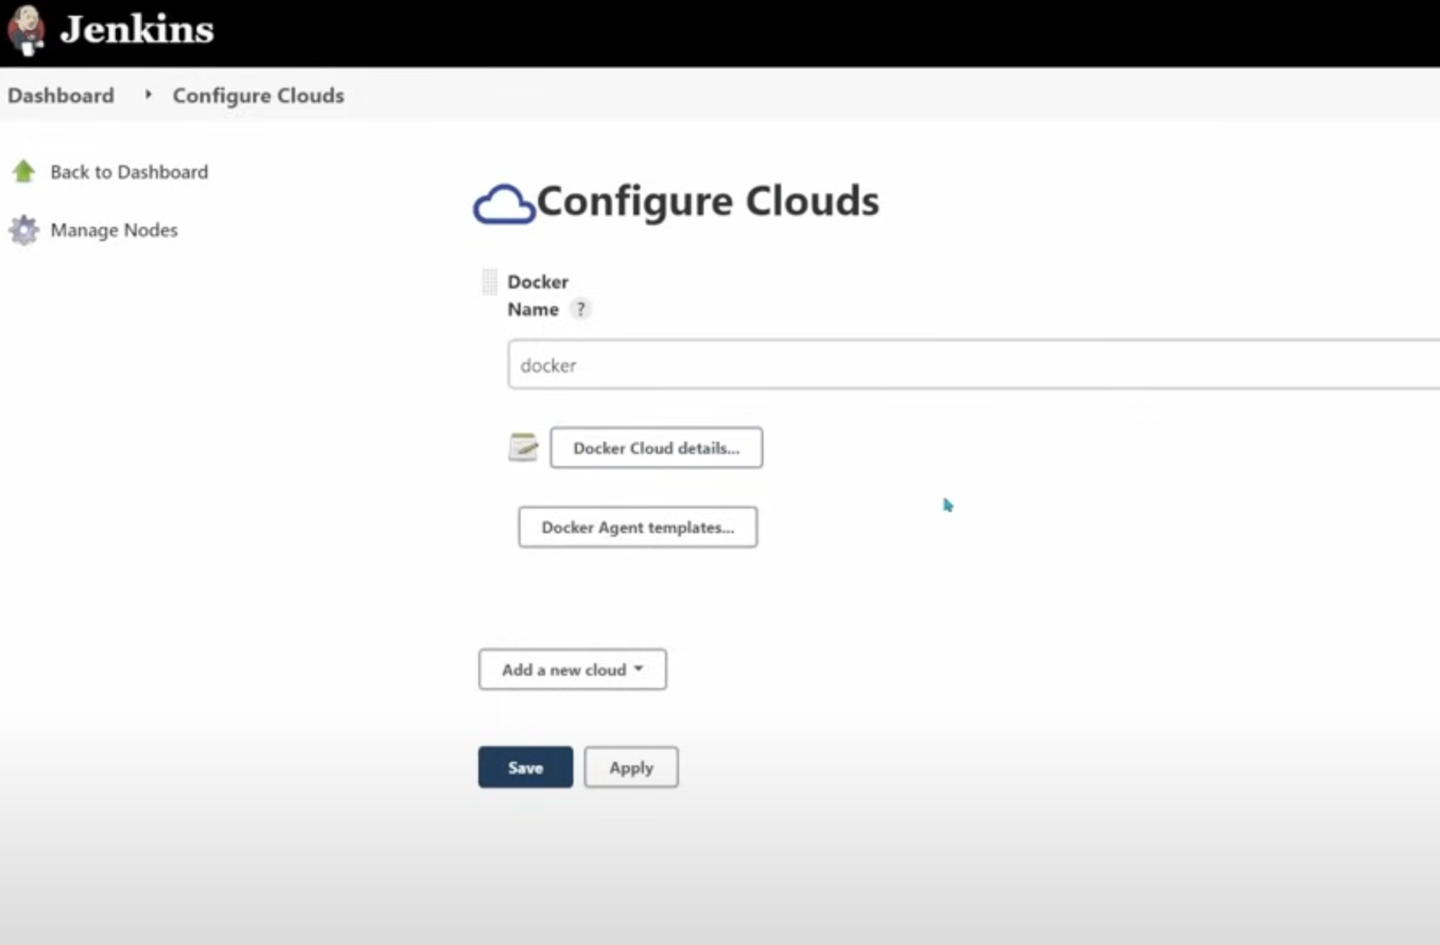

Slide 37
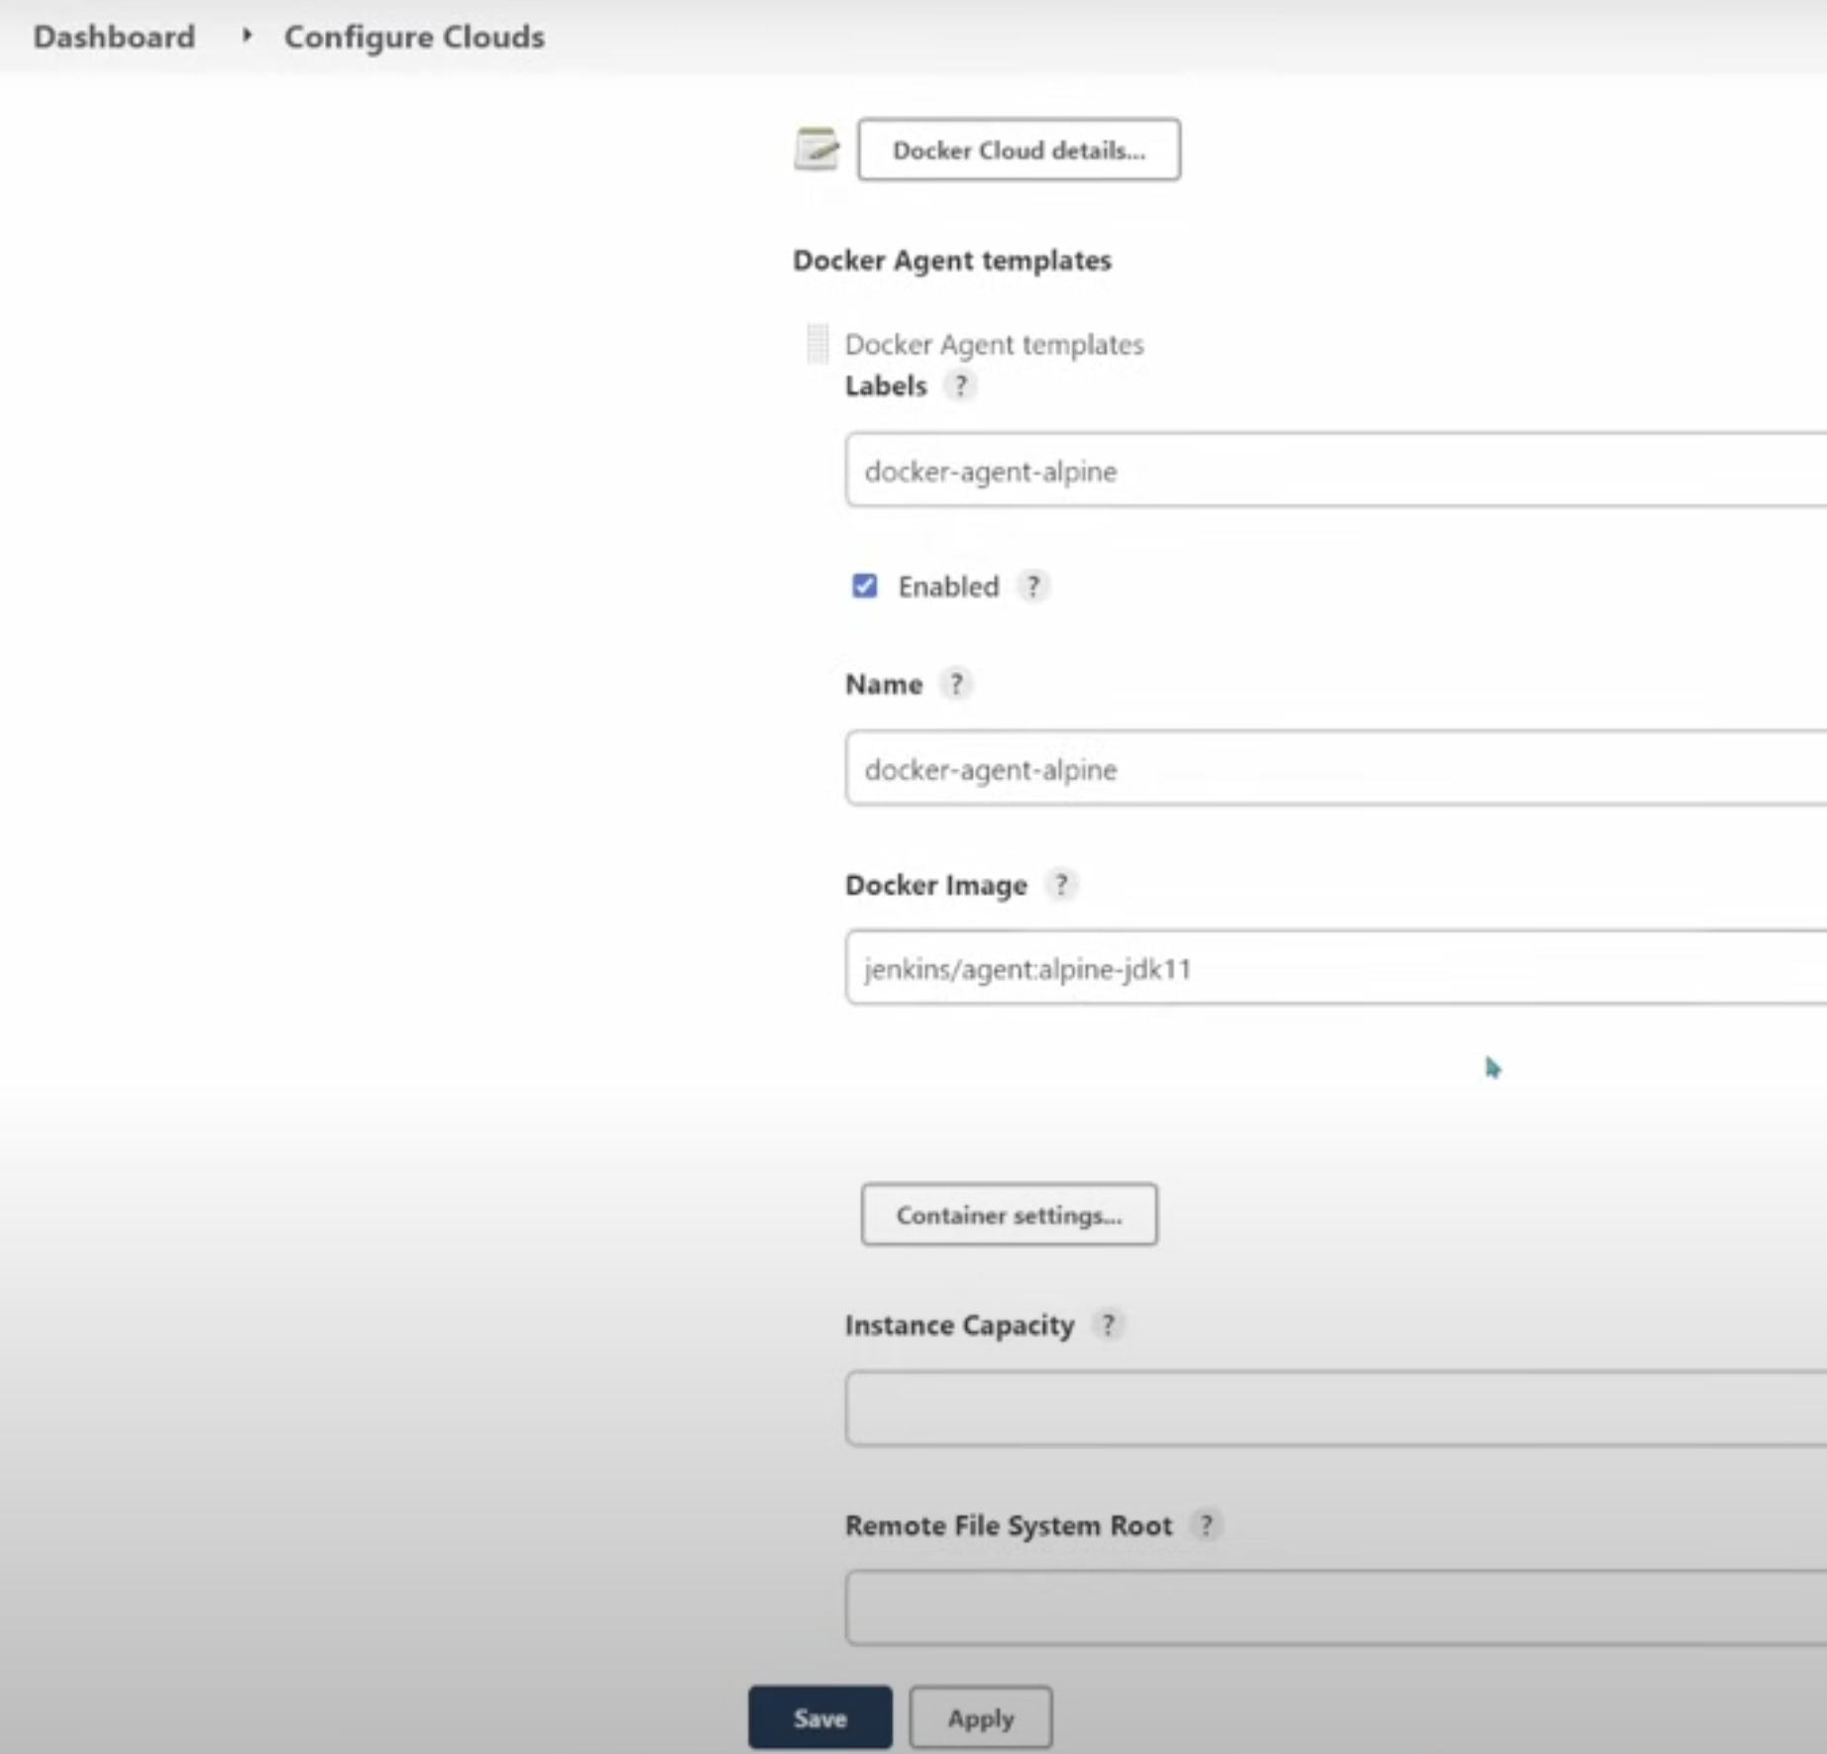
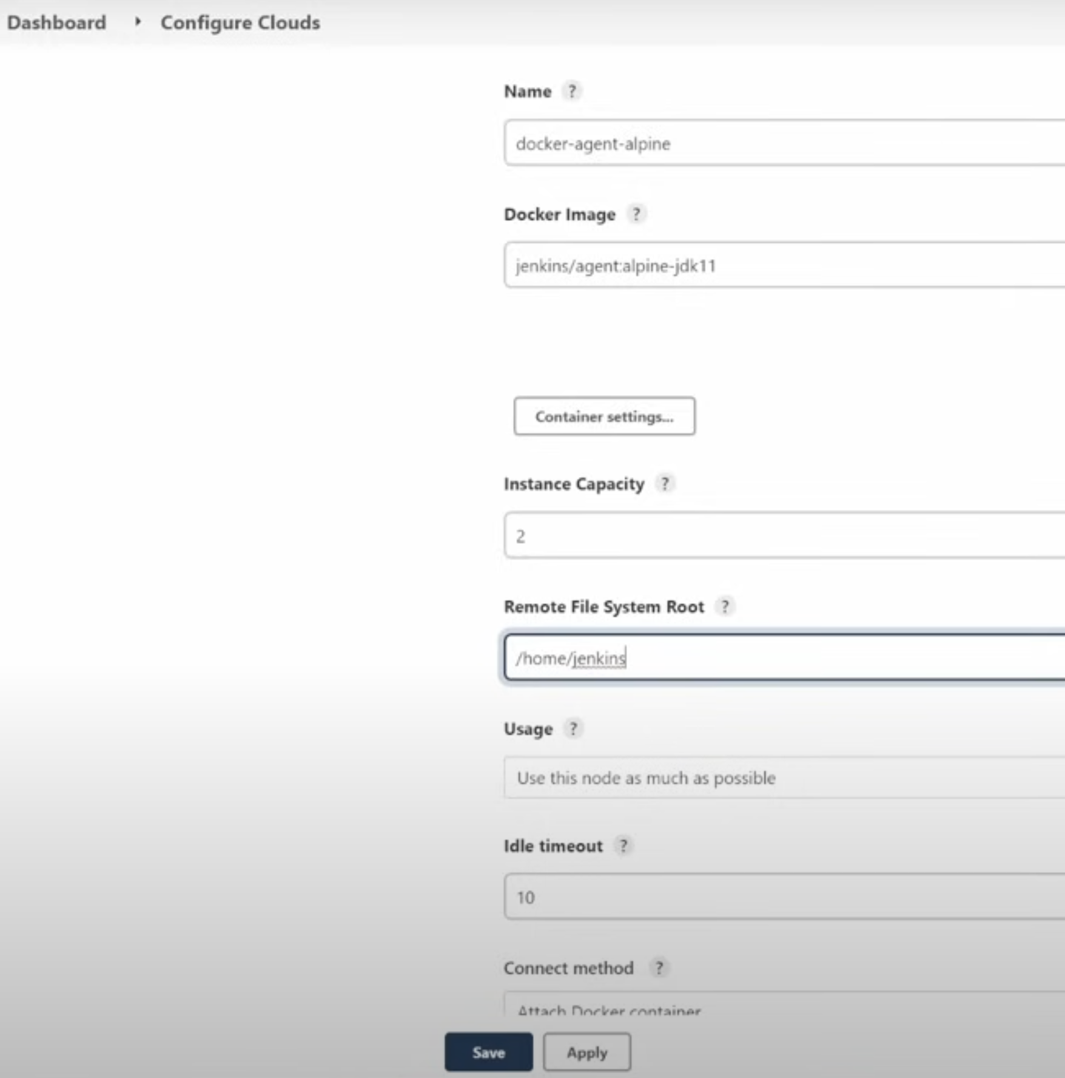
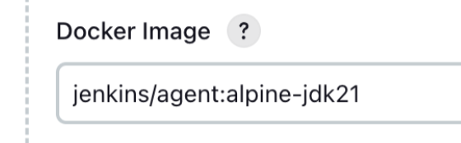
Create docker agent template

Slide 38
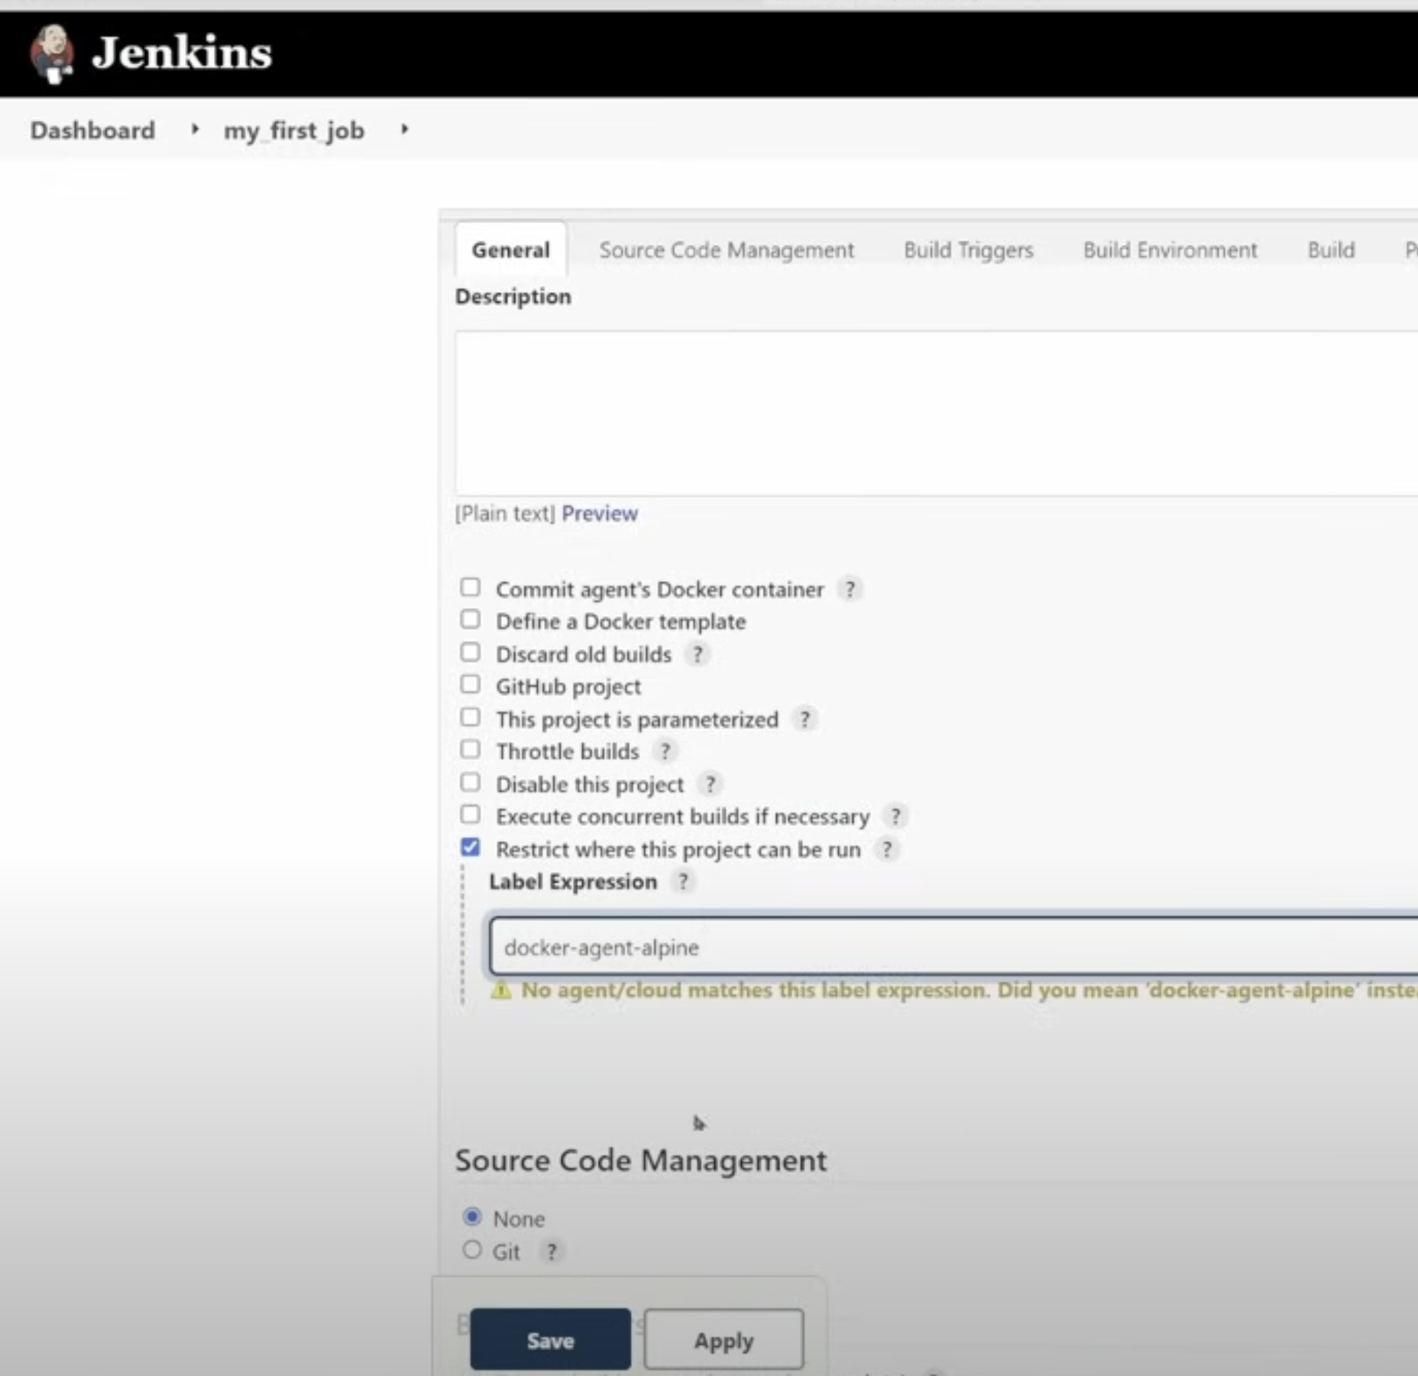
Configure project to run on an agent

Slide 39
Exercise
Run python on docker cloud agent.
What’s the result?

Slide 40
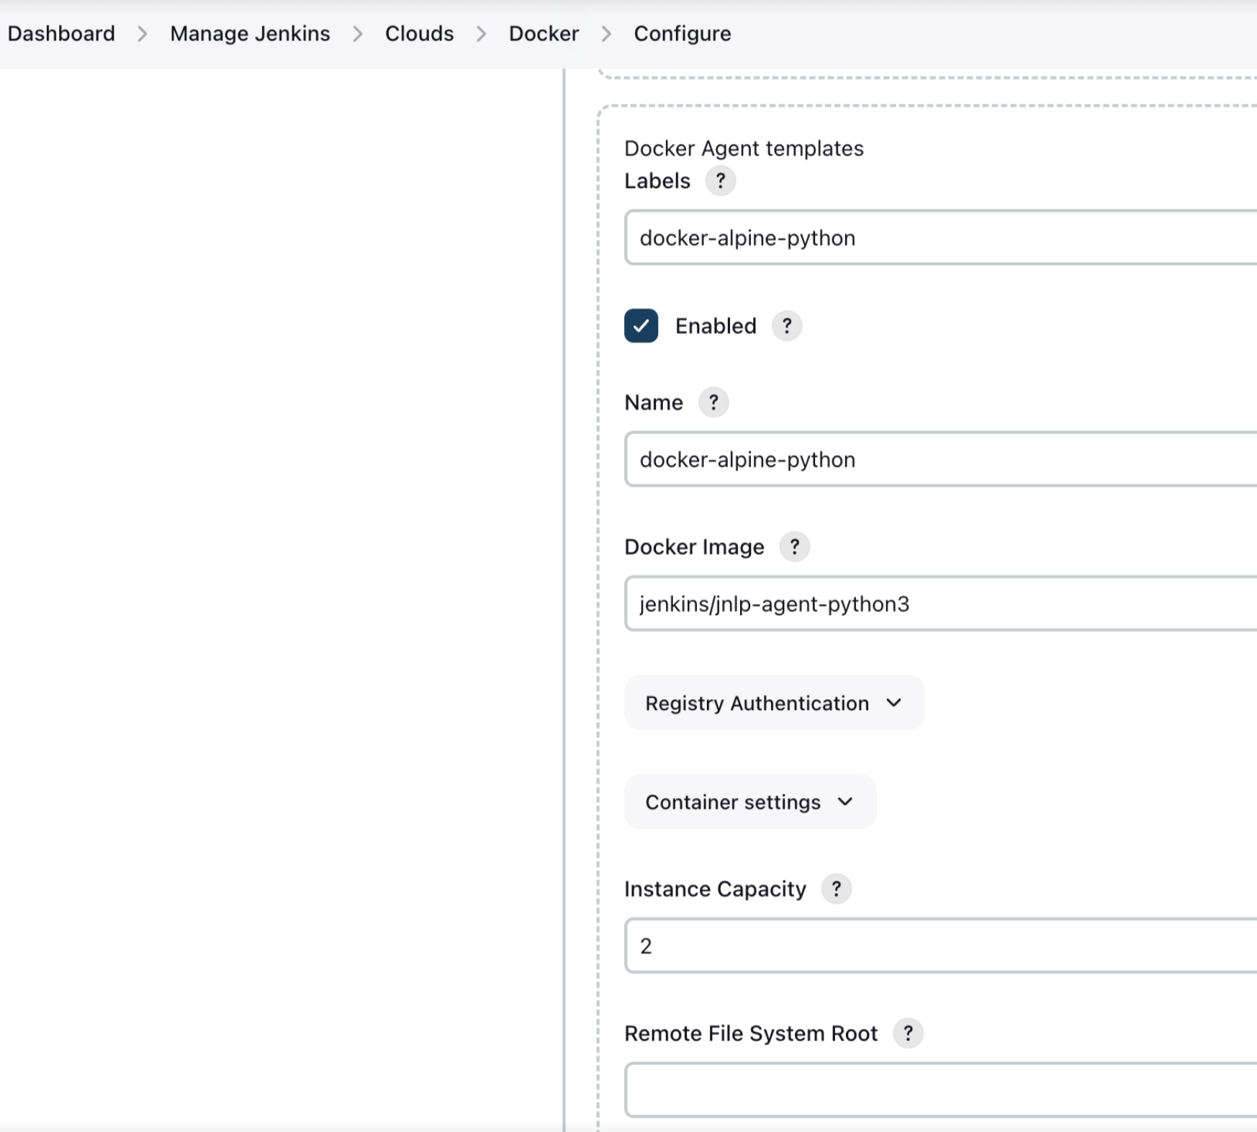
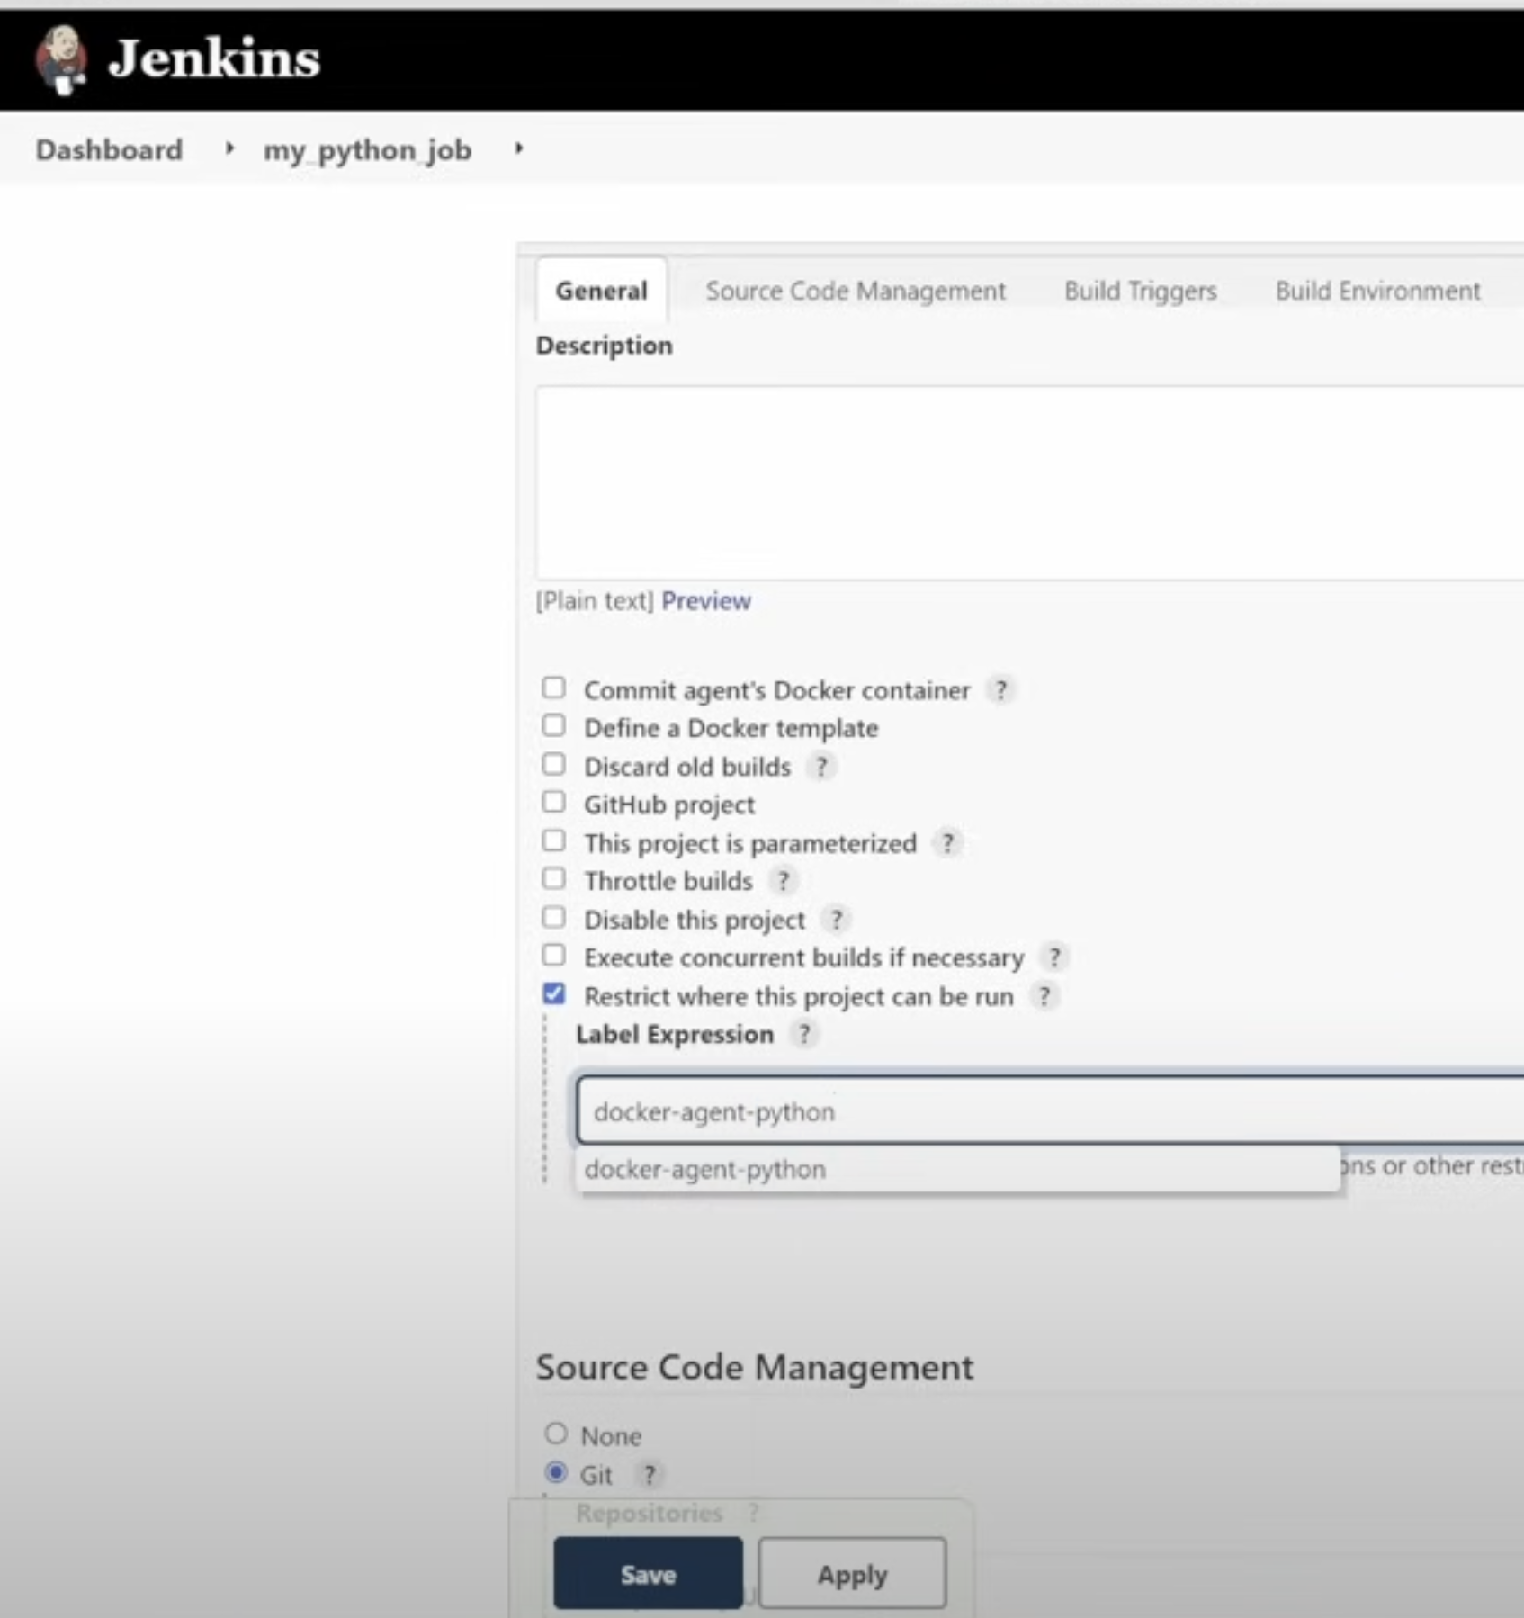
Configure agent for Python

Slide 41
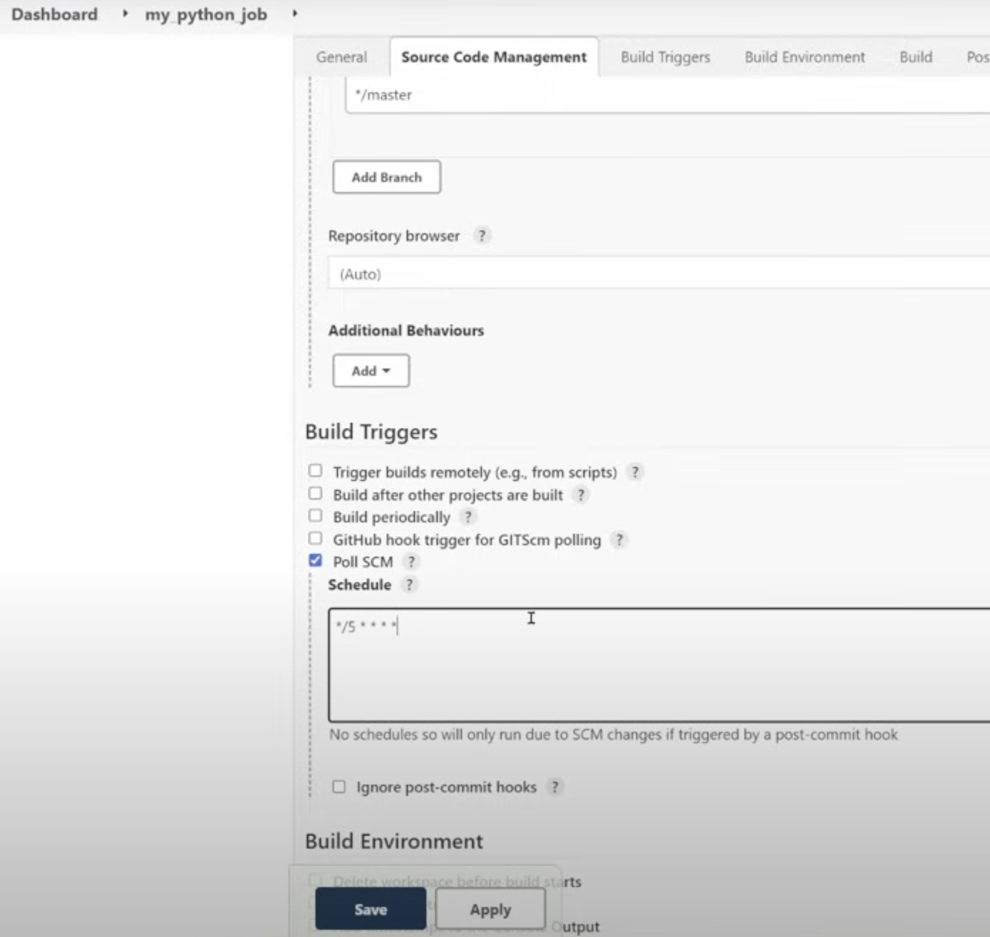
Configure job schedule
run every 5 mins
=
*/5****

Slide 42
Learning so far !
Install/setup Master
Setup Agents
Create freestyle Projects
Next !
Setup pipeline projects with groovy language

Slide 43
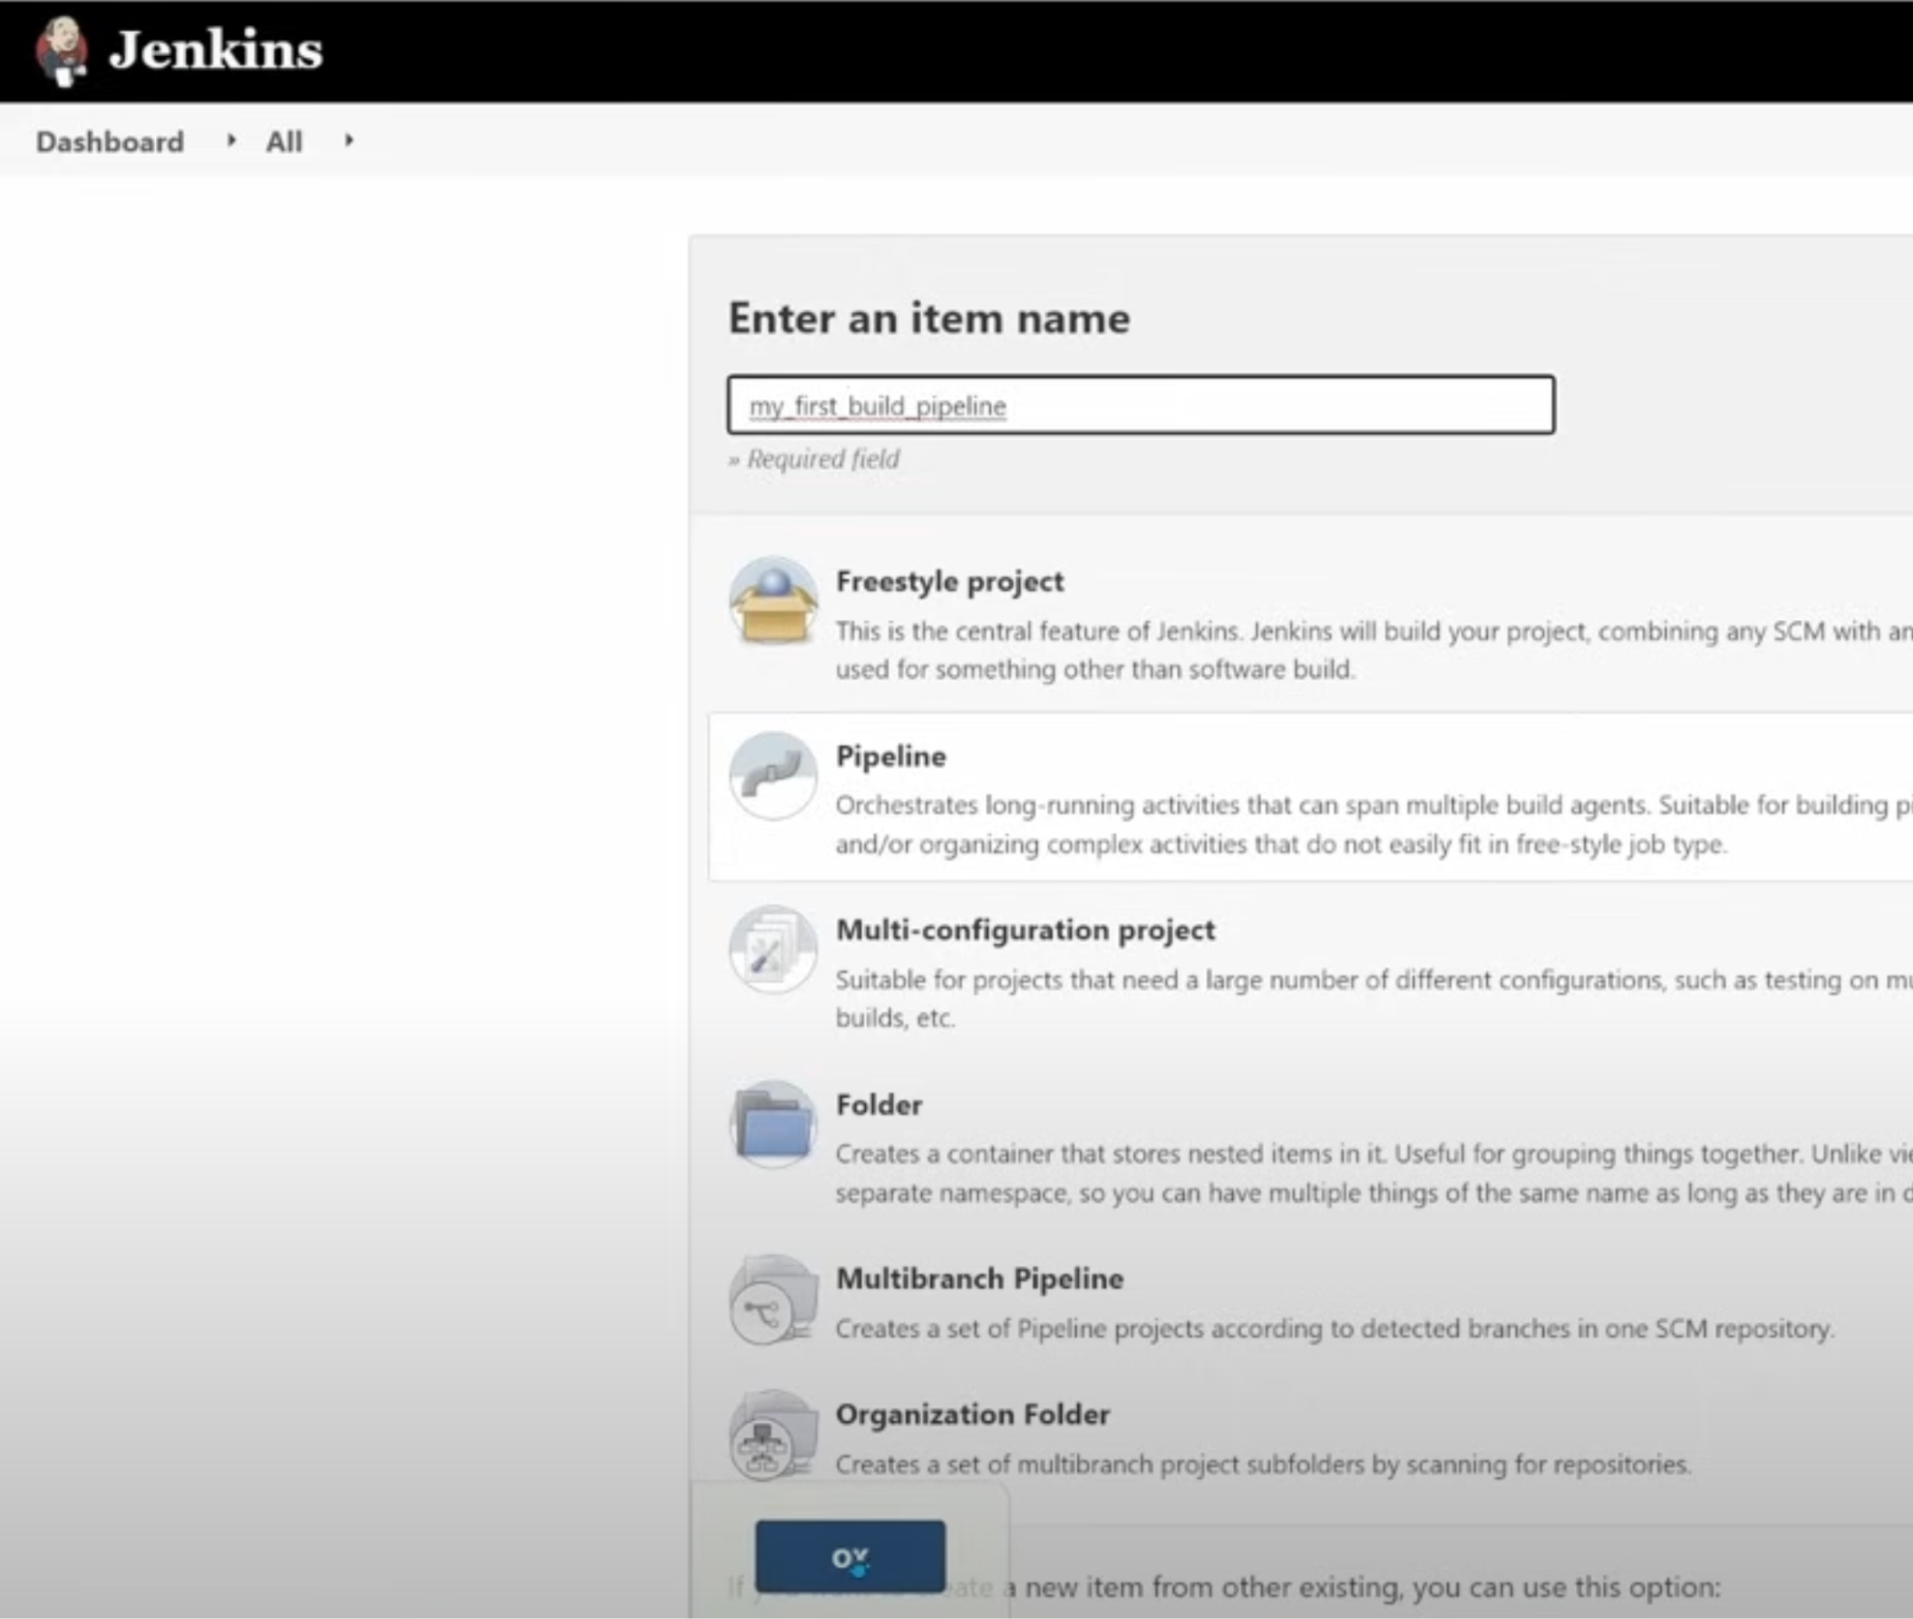
Create first pipeline project

Slide 44
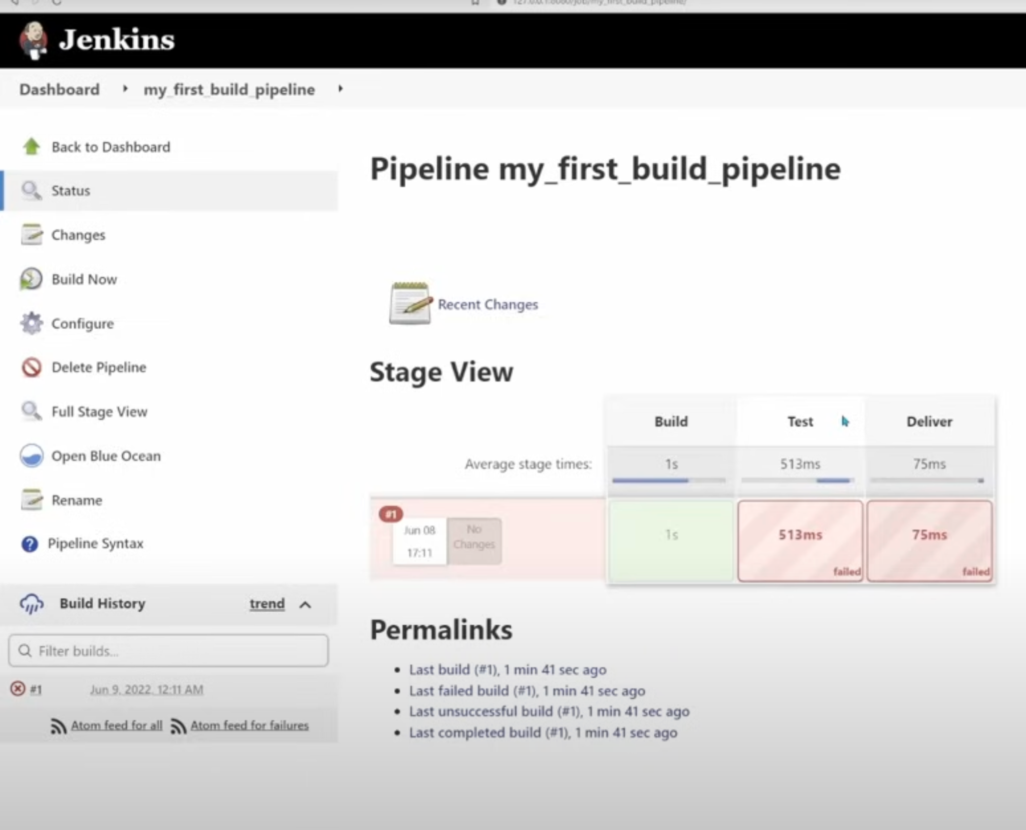

Slide 45
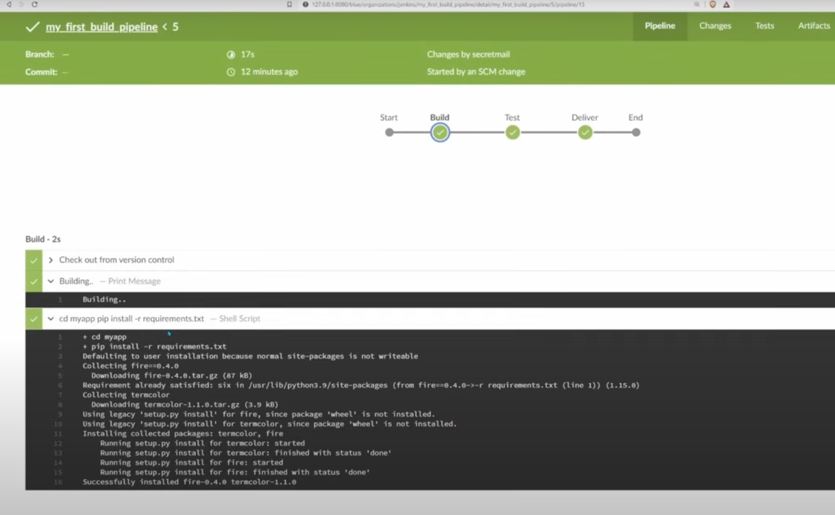
Blueocean plugin

